Slide 1
2017 Washington Leadership Summit
Apple Valley HR Association

Slide 2






Thank you to our sponsors

Slide 3
Welcome Jeremy Jordan 8:00am
It’s About Getting Better, Not Just Bigger Dave Gartenberg 8:10am
Caregiver / Community Engagement Jim Hall 8:55am
Emily Volland
--BREAK-- 9:35am
Designing Teams that Work Lauren Miller 9:45am
Growing Leaders of Excellence Mike Nash 10:35am
--LUNCH & VENDOR FAIR-- 11:30am
Interactive Learning Workshop Jeanne Semura 12:15pm
Small Employer Excellence Panel 1:30pm
--BREAK-- 2:25pm
Onboarding Into a Culture of Excellence Sarah McLamb 2:35pm
Non-Profit Excellence Cami Hanson 3:20pm
Attracting the Next Generation Dennis MicGreevy 4:00pm
2017 Washington Leadership Summit
Apple Valley HR Association

Slide 4
It’s About Getting Better, Not Just Bigger
Dave Gartenberg – Slalom, LLC
June 7th, 2017
2017 Washington Leadership Summit - Apple Valley HR Association
Notes:
Poll Everywhere – Who has heard of Slalom? How many years of HR Experience? If you weren’t in HR what profession would you be in?
here to share the story of how we've not just gotten bigger but better
this story is not just about me…i'm was hired to help preserve what they has, so it you walk away impressed with me, then you didn't hear the word story…ie leader values,,,,long term focus…but weren't scanning…John interview all director hires
I know many of you work in much smaller orgs … the 8 key take aways I will share are 100% relevant for companies of 5 to 50,000. Why 8?

Slide 5




Background
Notes:
Economic Analyst – more intrigued with how company run
Back to Grad school – Three important things 1. WB, 2. confirmed my passion, 3. Internal
21 Years across 2 fortune 100 companies (RH?)

Slide 6







Our Services
We help companies solve business problems and
build for the future.
Strategy and
Operations
Organizational
Effectiveness
Delivery Leadership
Information
Management
and Analytics
Customer
Engagement
Experience
Design
Technology
Enablement
Notes:
How we do it

Slide 7

4500+
EMPLOYEES
26
MARKETS
900+
CLIENTS
3
COUNTRIES
Notes:
Rapid growth <30% CAGR over the last decade

Slide 8
Our Core Values
Do what is right, always
Fuel growth and innovation.
Focus on outcomes.
Build and shape A better future.
Drive connection and teamwork.
Take ownership. Get it done.
Inspire passion and adventure.
Celebrate authenticity.
Stay humble and curious.
Smile.
Notes:
No one would ever recommend 10 Core Values…

Slide 9

External Validation
Fortune 100 Best Companies to Work For
Great Workplaces in Consulting & Professional Services
Best Workplaces for Diversity
Best Workplaces for Millennials
Best Workplaces for Generation X
People Companies That Care
Notes:
In the last year… We are not perfect…

Slide 10
8. The Business Is Your North Star
Notes:
Biz Acumen – Natural gravity for HR in an ivory tower. Would your business say you understand their needs? Get credibility, and possibly better solutions.
Listening Tour – don’t do what they ask for..dig underneath and typically find a legitimate need.

Slide 11
7. Time Is Your Most Limited Resource
Notes:
All the things you touch will add value…but all those things are not equal. The biggest determination of the impact you will have will be on what you choose note to do (x2).

Slide 12
6. Quarterly Extended 1:1s
Performance
Development
Engagement
Notes:
A way to ensure that you are not just cranking work out of your teams (and yourself) but growing and developing (which is right for the business and individual careers). Performance. Development. Engagement. Undocumented. Look back/forward 3 months.

Slide 13
5. Output = People x Process
Notes:
How you make a sustainable impact

Slide 14
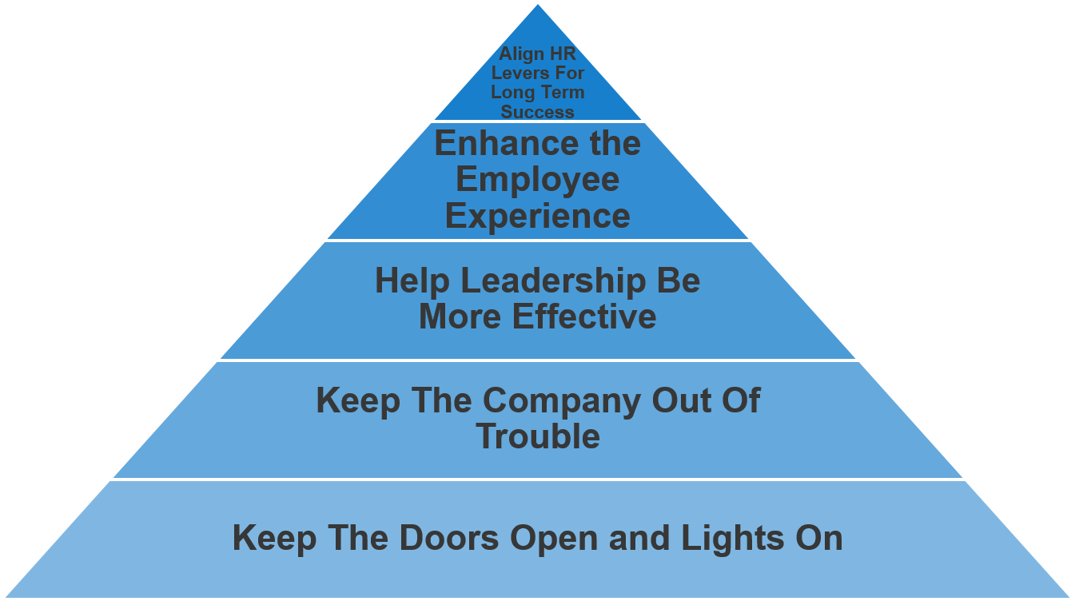




4. Maslow Was Onto Something
4. Maslow Was Onto Something
Notes:
Lean
Technology is your friend (anyone using Slack, MS Teams, Trello?)

Slide 15
3. Pay Yourself (&Your Team) First
Notes:
In our understaffed functions it’s easy (and understandable) to be heads down in your inbox and cranking out work. Here’s a dirty little secret that 25 years has taught me – you will never get caught up…and it’s ok. New hire 401K savings.

Slide 16

2. Be A Learner
Books
Flawless Consulting
Ulrich/Boudreau
Webinars
The Table Group
Center for Effective Organizations
Podcasts
HBR Ideacast
CEB Talent Angle
Notes:
Flawless (chaps on Contracting and Resistance)
CEB – outside the firewall
Once or twice a month…have a coffee with someone who has nothing to do with your day job.

Slide 17
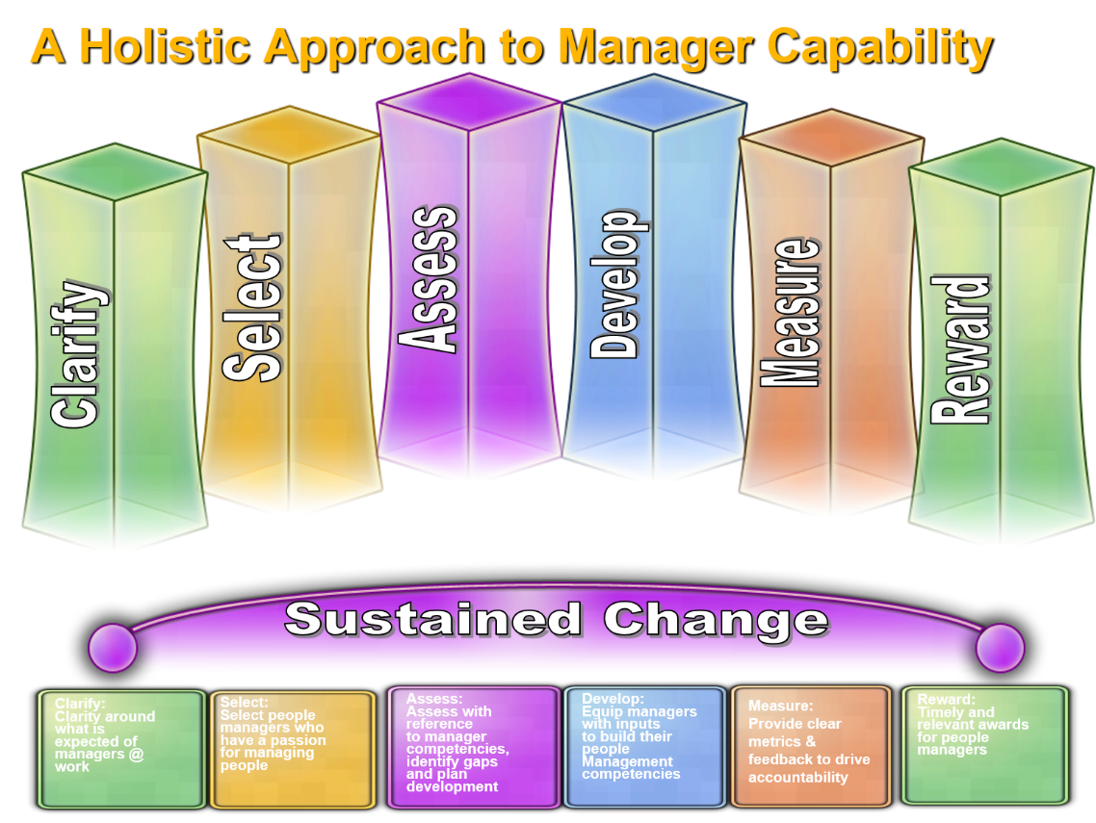
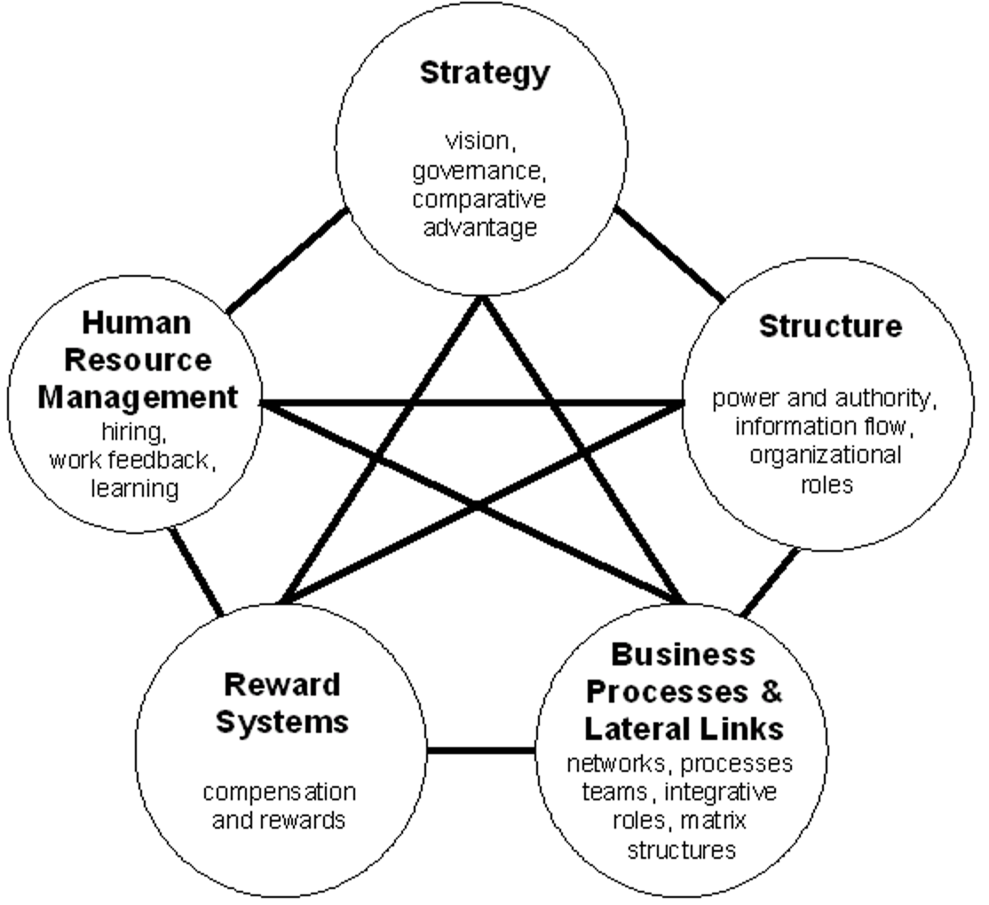
1. Don’t Confuse Activity With Impact
1. Don’t Confuse Activity With Impact
Notes:
Space where we do things which “feel” good, but don’t always accrue to a sustained result. Hawthorne Effect.

Slide 18


Q&A
slalom.com

Slide 19
DG@Slalom.com
Notes:
Other questions, points of view to make me smarter, connect on linkedin, coffee with someone who has nothing to do with your day job…

Slide 20
More than 70 years of changing lives

Slide 21
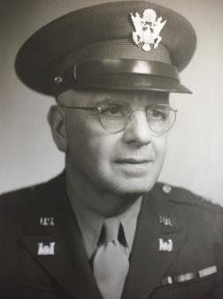

Kadlec History
Manhattan Project
Lt. Col. Harry Kadlec - 1944
Methodist Church - 1956
Multiple expansions
Steady growth
Regional Referral Center

Slide 22
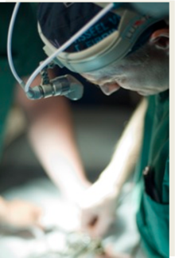
What Sets Kadlec Apart In Our Market?
High Risk Obstetrics/Perinatology
Neonatal Intensive Care
Neurosurgery
Cardiovascular surgery
Thoracic surgery
Interventional Cardiac Cath
Accredited Chest Pain Center with PCI

Slide 23
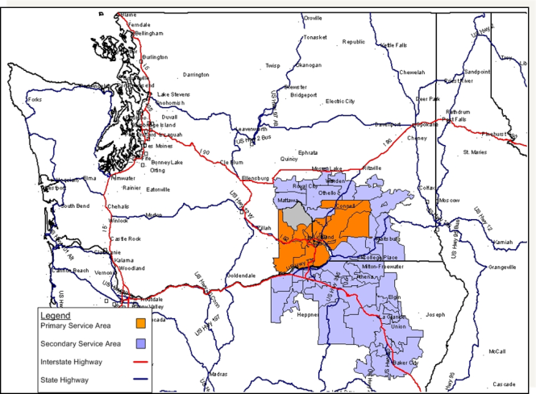
Kadlec Service Area

Slide 24
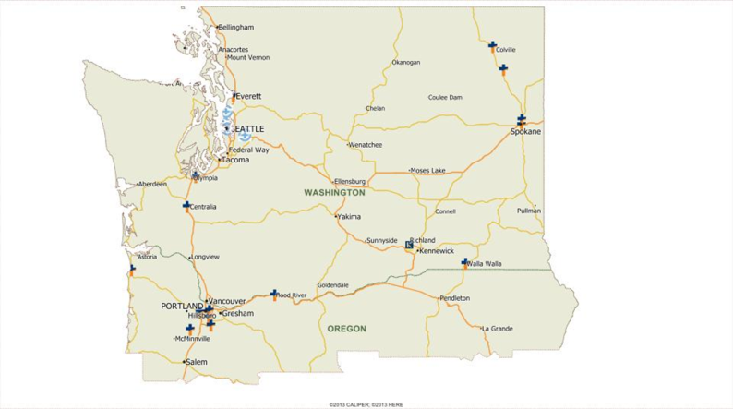

Providence Health & Services
Shared Missions
50 Hospitals
7 States
100,000+ Caregivers (employees)

Slide 25
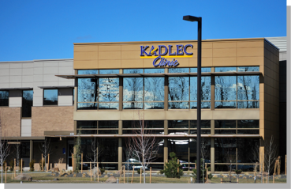
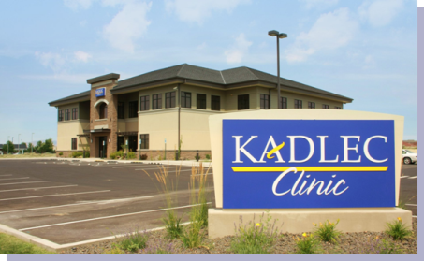
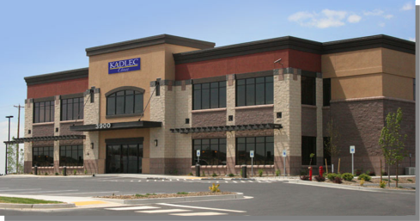
Kadlec Clinic
West Richland
Pasco
Kennewick

Slide 26
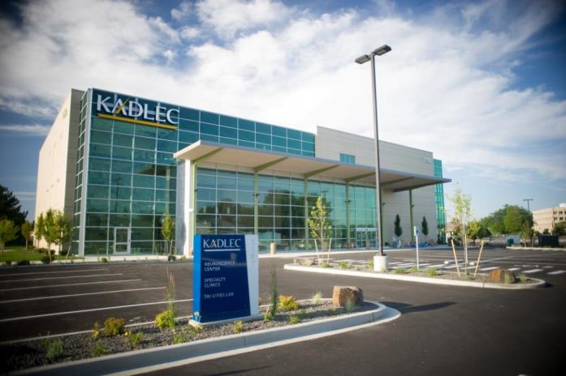
Specialty Physician Office Building

Slide 27
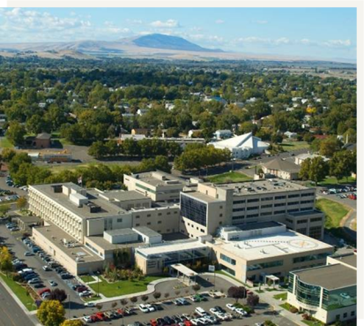


Kadlec Construction

Slide 28
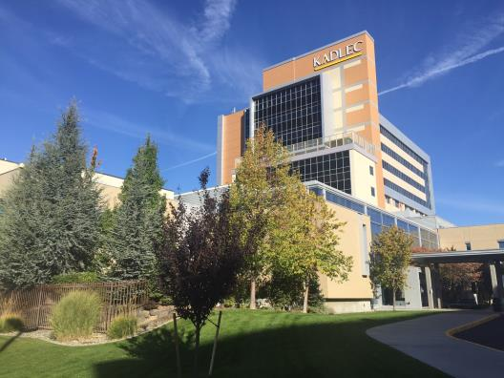
Kadlec Construction
Build top 4 floors of River Pavilion

Slide 29
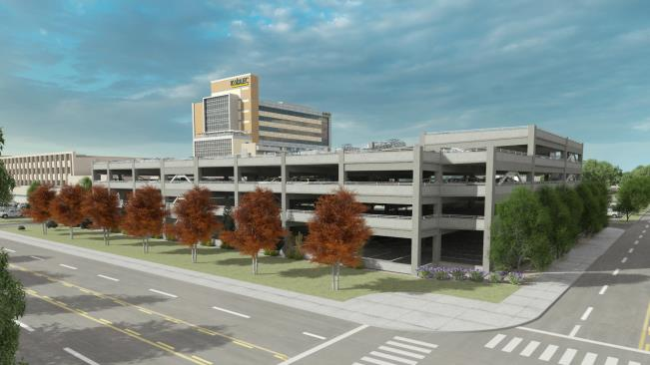
Kadlec Construction
Parking Garage

Slide 30
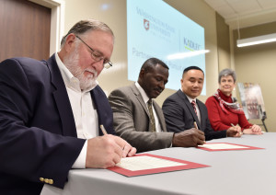
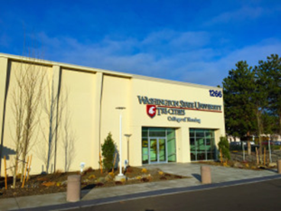

Investments in Education
Washington State University
Endowing Faculty for Doctor of Nurse Practice
Future Primary Care

Slide 31

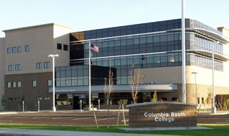

Columbia Basin College

Slide 32


Family Medicine Residency
Kadlec joins WWAMI Network
2nd group started July 1
18 total residents at
full capacity

Slide 33
What really sets Kadlec apart?
People
Relationships
Culture
Mission
Promise

Slide 34
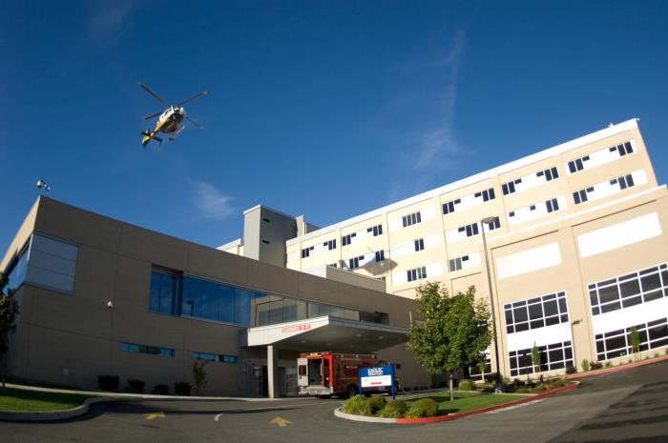
Thank you!

Slide 35


THE
LEADERSHIP MINDSET
2017 Washington Leadership Summit

Slide 36
JOHARI’S WINDOW
Known to self
Unknown to self
OPEN
GROWTH OPPORTUNITIES
Known to others
Known to both self and others
Unknown to self,
known to others
PRIVATE
HIDDEN
Unknown to others
Known to self,
unknown to others
Unknown to both self
and others

Slide 37


THE MORALE MANDATE
What do you get when you get low morale?
What do you get when you get high morale?

Slide 38
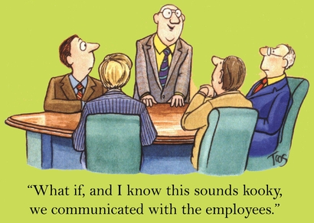
WHERE DOES WORKPLACE MORALE COME FROM?

Slide 39
15%
20%
The Individual
Your Coworkers
Workplace Morale
25%
40%
WHAT ARE THE FOUR MAIN SOURCES OF WORKPLACE MORALE?

Slide 40
15%
20%
The Individual
Your Coworkers
Workplace Morale
25%
40%
The Work
WHAT ARE THE FOUR MAIN SOURCES OF WORKPLACE MORALE?

Slide 41

THE WORK
Four ways "the work" impacts morale
1. I like the work itself
2. The "challenge/competency" continuum
I feel
challenged
I feel
competent
3. My work feels important
(I'm doing good in the world)
4. The organization is successful

Slide 42
15%
20%
The Individual
Your Coworkers
Workplace Morale
25%
40%
The Work
Leadership
80% of exiting employees are quitting their BOSS
WHAT ARE THE FOUR MAIN SOURCES OF WORKPLACE MORALE?

Slide 43
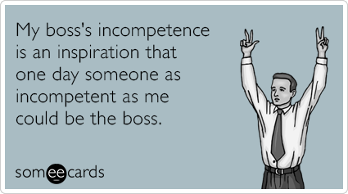
THE PETER PRINCIPLE
Employees tend to get promoted to their level of incompetence.
(Observed by Dr. Laurence J. Peter in 1968)
And the antidote:
LEADERSHIP TRAINING

Slide 44
THREE TYPES OF COMPETENCIES
Job-Specific
Skills
The ability to write a brief, give an IV, repair a computer, or play the piano
Delegation skills, computer skills, public speaking,
management
skills
Transferrable
Skills
Adaptive Skills
Flexibility, how we handle stress, teachability,
being non-defensive, listening, and
communicating effectively…

Slide 45
ADAPTIVE SKILLS:
THE 50/50 PROPOSITION
Mind & Heart
50%
Behaviors
50%
Mind & Heart
We work on changing our attitudes and beliefs.
Behaviors
Hallmarks of behavior centered adaptive skills:
1. We break the adaptive skill down into its component behavioral parts.
2. We practice those behaviors over and over again.
3. We offer ourselves a whole lot of compassion.

Slide 46
BEHAVIORAL BASED ADAPTIVE SKILLS:
The 4 Stages of Development
Unconscious Incompetence
You don’t know that you don’t know how to do something.
Conscious Incompetence
You know that you don’t know how to do something, and it bothers you.
Conscious Competence
You know that you know how to do something, and it takes effort.

Slide 47

Great Listening Skills
(In 6 Component Parts)
The Behaviors:
Body language
  Eye contact
  Attentive posture, gestures and facial expressions
Shut up
  Don't interrupt
  Watch your "air time"
Paraphrase
Ask questions
Avoid distractions
Empathetic reflection

Slide 48
BEHAVIORAL BASED ADAPTIVE SKILLS:
The 4 Stages of Development
Unconscious Incompetence
You don’t know that you don’t know how to do something.
Conscious Incompetence
You know that you don’t know how to do something, and it bothers you.
Conscious Competence
You know that you know how to do something, and it takes effort.
Unconscious Competence
You know how to do something, and it is second nature, and you rock at it.
Conscious
Competence
You know that you know how to do something, and it takes effort.
Unconscious Competence
You know how to do something, and it is second nature; you rock at it.

Slide 49

UNDERSTANDING & MANAGING THE
POWER DIFFERENTIAL
The "power differential" has 3 distinct ingredients:
1. The actual power you have over your employees
Two Questions:
In what areas do you have power over your employees?
How do most adults feel about others having control
over them?

Slide 50
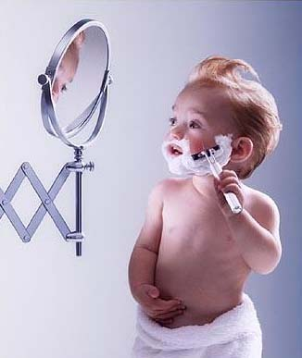
UNDERSTANDING & MANAGING THE
POWER DIFFERENTIAL
The "power differential" has 3 distinct ingredients:
2. The employee’s own past experiences with authority
Dependence
Counter Dependence
(Child)
(Teen)
Independence
Interdependence
(Adult)
(Healthy Adult)

Slide 51

3. Your behaviors
What behaviors could exaggerate the power differential?
  Angry or aggressive tone
  Over-reacting
  Announcing your power differential (“Because I’m the boss…”)
  Telling people what they’re supposed to think or feel
  Talking at, over or for people
  Talking too much
  Condescension/sarcasm (“apparently…”)
  Over functioning – the “savior complex”
  Micromanaging
  Threats
  Sharing your opinions first
  Shaming
  Defensiveness

Slide 52
3. Your behaviors
What behaviors could mitigate the power differential?
  Create SAFETY
  Stay calm, and practice emotional consistency
  Smile, be relational, check in, MBWA
  Be non-defensive
  Listen!
  Have some fun
  Affirmations, appreciation, showing you value the employee
  Take the blame and give the credit
  Ask for (and truly consider) others’ opinions
  Delegating/empowering/letting go/trusting
  Share information freely
  Practice humility

Slide 53

LET’S PLAY THE “POWER DIFFERENTIAL” GAME!

Slide 54

THE 3 WAYS FAMILIES
(AND ORGANIZATIONS) CHANGE THEIR CULTURE
1. Great parenting skills
Organizational equivalency:
Great management skills
2. A cohesive parental relationship
Organizational equivalency:
A cohesive leadership team
A. How you get along RELATIONALLY
B. Being on the same page PRACTICALLY
3. Healthy house rules
Organizational equivalency:
Healthy policies and practices

Slide 55

THE TOP 15 MANAGEMENT SKILLS
(FOR BUILDING EFFECTIVE ORGANIZATIONS)

Slide 56


THE TOP 15 MANAGEMENT SKILLS
(FOR BUILDING EFFECTIVE ORGANIZATIONS)
Show caring and respect
People know you see them as people, not just employees
Advocate for your employees
You stand up for your group – you go to bat for them
3. Communicate, communicate, communicate
Information is distributed effectively –
people know what’s going on

Slide 57

THE TOP 15 MANAGEMENT SKILLS
(FOR BUILDING EFFECTIVE ORGANIZATIONS)
1. Show caring and respect
2. Advocate for your employees and for the team
3. Communicate, communicate, communicate
Be fair and equitable
People are given equal respect, opportunity,
and understanding
Involve others in decision making…. be collaborative
You ask for people’s opinions, ideas, suggestions – and you listen

Slide 58


THE TOP 15 MANAGEMENT SKILLS
(FOR BUILDING EFFECTIVE ORGANIZATIONS)
1. Show caring and respect
2. Advocate for your employees and for the team
3. Communicate, communicate, communicate
4. Be fair and equitable
5. Involve others in decision making….be collaborative
6. Give people autonomy & trust
This is all about “ownership”
7. Ask for (and be open to) feedback
You don’t know what you don’t know
8. Deal with issues – fix problems

Slide 59

THE TOP 15 MANAGEMENT SKILLS
(FOR BUILDING EFFECTIVE ORGANIZATIONS)
1. Show caring and respect 5. Involve others in decision making….be collaborative
2. Advocate for your employees and for the team 6. Give people autonomy & trust
3. Communicate, communicate, communicate 7. Ask for (and be open to) feedback
4. Be fair and equitable 8. Deal with issues
9. Be approachable
Effectively deal with the “power differential”
10. Give recognition and thanks
Water the flowers that you want to grow
11. Hold people accountable
Unhelpful behaviors are addressed effectively

Slide 60

THE TOP 15 MANAGEMENT SKILLS
(FOR BUILDING EFFECTIVE ORGANIZATIONS)
1. Show caring and respect 6. Give people autonomy and trust
2. Advocate for your employees/team 7. Ask for (and be open to) feedback
3. Communicate, communicate, communicate 8. Deal with issues – fix problems
4. Be fair and equitable 9. Be responsive
5. Involve others in decision making 10. Give recognition/praise
11. Hold people accountable
12. Be available and responsive
Engage in M.B.W.A. and return emails and calls!
13. Follow through and follow up
Do what you say you’re going to do and…see #3 above!
14. Make your expectations clear
Be specific – and provide ‘sponsorship’
15. Provide resources and training

Slide 61
THE TOP 15 MANAGEMENT SKILLS
(FOR BUILDING EFFECTIVE ORGANIZATIONS)
1. Show caring & respect
2. Advocate for your team
3. Communicate!
4. Involve others in
decisions…be collaborative
5. Be fair and equitable
6. Give autonomy & trust
7. Ask for feedback
8. Deal with and fix problems
9. Be approachable
Give recognition & thanks
11. Hold people accountable
Be available & responsive
13. Follow through & follow up
Make your expectations
clear
Provide resources/training

Slide 62
THE
LEADERSHIP MINDSET
www.NashConsulting.com
Michael Nash mike@nashconsulting.com 425.298.7616

Slide 64

2017 Washington
Leadership Summit
Building and Sustaining Organizational Excellence

Slide 65
Tools to
Engage everyone
Jeanne Semura, PhD
Consultant, Organizational Excellence, Finance and Administration
Notes:
https://www.washington.edu/brand/graphic-elements/font-download/
66% of employees in organizations in the US are not engaged or are actively disengaged.
Why?
Have you experienced a boring meeting where:
You feel excluded or marginalized,
People don’t speak up
Group process is drudgery
Deciders and doers are separated
People are deliberately excluded because it slows you down
Great ideas disappear into the ether?

Slide 66
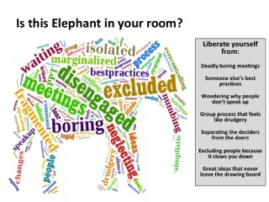
66% of Us employees not engaged march 2016 - Gallup
49.5% employees “not engaged”
16.5% of employees were “actively disengaged”
Notes:
In March 2016 the Gallup Polls, reported that 34.1% engagement is a new high, from the 33% in previous years.
In addition, the field of higher education is shifting rapidly.

Slide 67
2016 Trends report:
10 key shifts in higher education
Fresh wave of attacks on free speech, often from students
Efforts to combat sexual assault by creating new cultural norms on campus
Growing use of metrics to measure faculty productivity
Need for leaders to react quickly to events that could quickly spin out of control
Widespread attacks on shared governance
Outsourcing services not core part of mission
Increased scrutiny of academic research
Movement to overhaul college transcript
The rise of instructional designer
Better marketing to survive enrollment challenges and create institutional identify
The Chronicle of Higher Education, Special Report February 29, 2016
Notes:
In addition,
Access,
Equity
Diversity
Cost
Revenue Generation

Slide 68
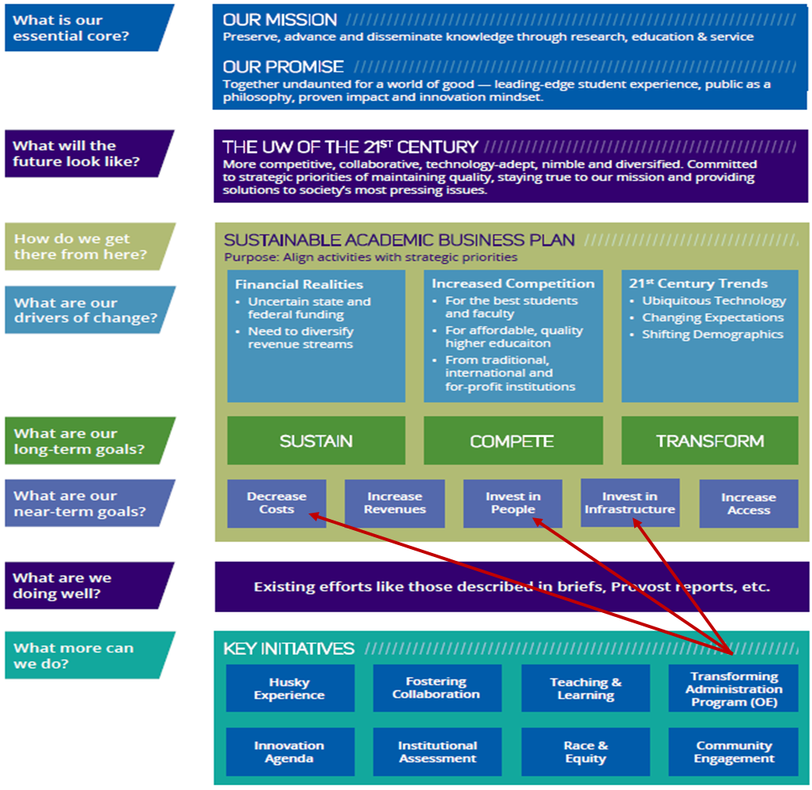
Uw strategy 2016
Sustainable academic business plan

Slide 69
Uw transforming administration program
Launched in April 2015
Transforming Administration Program
Organizational Excellence (OE)
Enhance the culture of service in UW’s central administration
Bring administrative units together to work as one UW administration with common:
  Vision,
  Culture of service, and
  Commitment to continuous improvement
Sponsored by Provost and President under the 2y2d Initiative and the Sustainable Academic Business Plan, OE:
Leads UW in improving organizational effectiveness and
Helps:
  Schools/colleges and
  Support units improve their effectiveness

Slide 70
Organizational Excellence
Services
Business Plan Development | Process Improvement (Lean)
Change Management | Project Management
Conflict Resolution | Retreat Facilitation
Metrics, Analysis & Reporting | Strategic Planning
Organizational Assessments

Slide 71






Agenda
1-2-4 ALL
Engage everyone simultaneously in generating questions/ideas/ suggestions
TRIZ
Stop counterproductive activities to make space for innovation
25/10 Crowd Sourcing
Rapidly generate & sift a group’s most powerful actionable ideas
What, So What, Now What?
Together, look back on progress to-date and decide what adjustments are needed

Slide 72
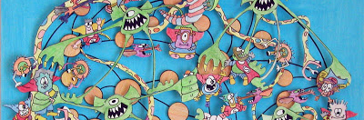
1-2-4-All
Engage everyone simultaneously in generating ideas, questions, or suggestions

Slide 73
Invitation
How do we plan strategies and set goals within our organizations to attract talent?

Slide 74

Sequence of Steps & Timing
Alone, generate a response to the invitation (1 min)
Pairs, share what you came up with and mutually shape the ideas (2 mins)
Quartets, try to synthesize a contribution (4 mins)
All, hear from any groups with something everyone needs to hear (4-10 mins)
Repeat in rapid cycles to add clarity, depth, or diversity

Slide 75
Example Invitations & Uses
INVITATIONS
What’s your recommendation for what we should do next?
What do you want to know about the work ahead but dare not ask?
What’s a challenge you have that’s preventing us from making progress?
Generate a list of your boldest ideas for X
…
USES
During a meeting to discuss agenda topics or items
To replace brainstorming
To make sense of complex data or situations
…

Slide 76
TRIZ
Stop counter-productive behaviors to make space for innovation

Slide 77
What is a worst result of your goal to attract talent?
Consult with someone near you.

Slide 78
What is everything you could do to guarantee that worst result?
Make a list…

Slide 79
Is there anything on your list that resembles a current behavior or practice?
Be unforgiving...

Slide 80
  How are you going to
  STOP IT ?

Slide 81
  What’s your first move to shifting this counter-productive pattern?

Slide 82
  What triggers these behaviors?
Bonus

Slide 83
  How do you know you are about to fall back into those behaviors?
Bonus

Slide 84
  What do you need from others to help you STOP IT ?
Bonus

Slide 85
TRIZ: Schedule of Steps & Sequence
1. First alone, then in your small group, compile a list of to-do’s in answer to:
How can I/we reliably create…
Go wild!
2. First alone, then in your group, go down your list and ask:
Is there anything we are doing that resembles in any shape or form to-do’s on our list?
3. First alone, then in your group, compile the list of what needs to be stopped
Ask: How am I and how are we going to stop it? What is your first move to STOP this behavior?
Be as concrete as you can
Bonus questions:
  What triggers this behavior?
  What competing commitments and assumptions may be holding you back?
  What do you need from others to STOP?

Slide 86
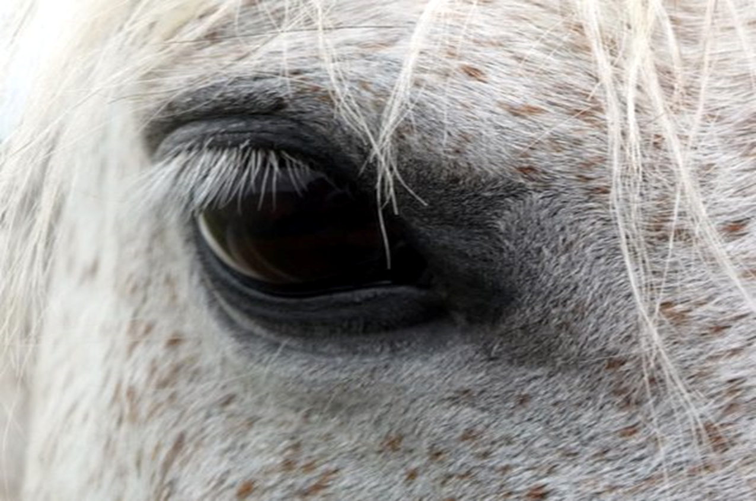
25/10 Crowd Sourcing
Rapidly generate and sift a group’s most powerful actionable ideas
On index cards, each participant writes:
If you were 10 times bolder and in charge of redesigning some aspect of attracting talent, what would you do to boost the love of learning AND practical skill development simultaneously?
What is your first move?
  No names
  Write legibly

Slide 87

25/10 Crowdsourcing
Rapidly generate and sift a group’s most powerful actionable ideas
Pass cards around while milling
5 rounds
Rate each card: 1 = ho-hum to 5 = fabulous, “I’m in!”[adjust scale to the challenge]
Decide* before looking at other scores Put rating on the back of the card
* Option: before you score your card, confer with one other person for 2 minutes

Slide 88
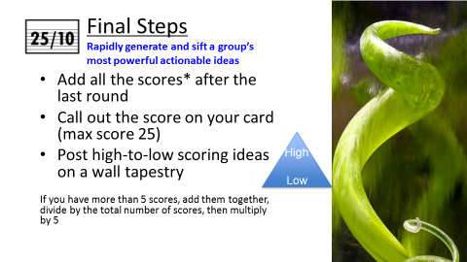

Slide 89



What³ Debrief
Together, look back on progress and decide what adjustments are needed *
WHAT? [5 minutes]
    Looking back, what facts, data, & observations stand out?
SO WHAT? [5 minutes]
    How do you explain those facts? Assumptions? Patterns? What is important?
NOW WHAT? [5 minutes]
    What action may help you move forward? Who else should be here?
* Twist: With use of talking objects
Notes:
One

Slide 90

What did you notice?
What was structured? What was liberated?
What opportunities do you have to use this LS?
What invitation would you make?

Slide 91
Liberating structures
Including and unleashing everyone
Simple: takes a few minutes to
introduce
Expert-less: beginners can succeed
right away
Results-focused: helps generate
better-than-expected, innovative results
Rapid cycling: fast iterative rounds
are very productive
Innovative: sparks creative
relationships with clients or customers
Inclusive: together, everyone is
invited to shape next steps
Multi-scale: works for everyday
solutions, big projects, strategy, &
transforming movements
Seriously fun: boosts freedom &
responsibility
Self-spreading: easy to copy without
formal training
Adaptable: spreads with fidelity and
adapts to local conditions via Minimum Specifications

Slide 92
We are Changing how we meet, Plan, conference and relate to each other
“it (Liberating Structures) puts in the hands of every leader and every citizen the facilitative power that was once reserved for the trained expert….”
  Peter Block, author,
  Flawless Consulting, Stewardship, and Community

Slide 93
Learning resources
Organizational Excellence
http://www.washington.edu/2y2d/oe
Transforming Administration Program
https://tap.uw.edu/

Slide 94
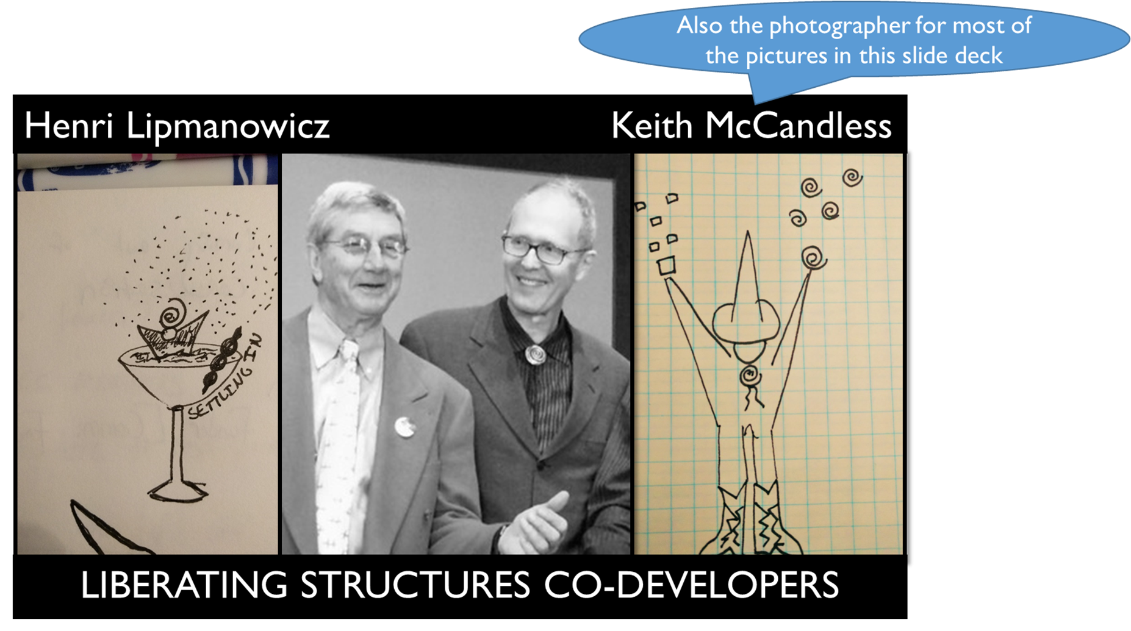

Slide 95



Made available through a Creative Commons Non-Commercial, Attribution, Share-and-Share Alike License
You can use ‘em, you can share ‘em,
but you can’t sell ‘em
Slide content adapted from materials developed by Keith McCandless
Most photographs by Keith McCandless

Slide 96

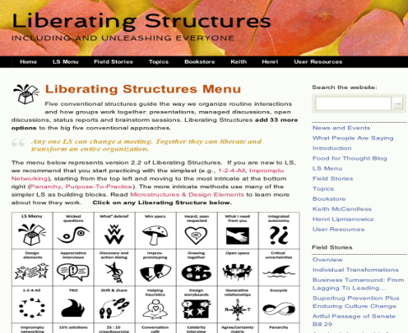
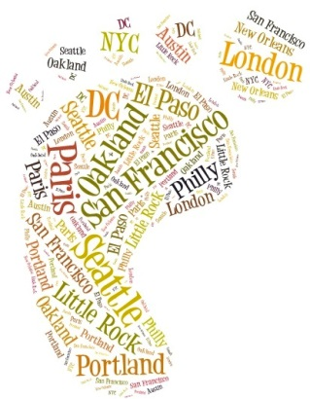
Learning resources
Liberating structures
The Surprising Power of Liberating Structures: Simple Rules to Unleash A Culture of Innovation
by Henri Lipmanowicz & Keith McCandless
Website
www.liberatingstructures.com
Keith McCandless
keith@liberatingstructures.com
LS Users Groups in Washington - Seattle, Olympia, Pullman
25+ users groups across US, Canada, Europe, New Zealand, India

Slide 97
Thank you
I’d love your feedback on the value of this session or any questions you may have
Jeanne Semura, PhD, Consultant
Organizational Excellence
Finance and Administration
University of Washington
Box 351248
Seattle, WA 98195-1248
Email: semurj@uw.edu
Phone: 206-543-8766

Slide 98
Small Employer Excellence Panel
Washington Leadership Summit 2017

Slide 99
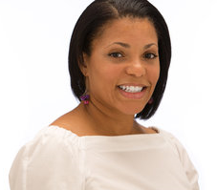

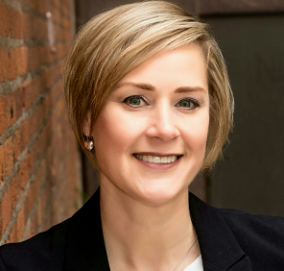
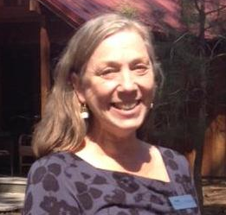
Daphne Williams, Empire Health Foundation
Director of Human Resources
Rachel Cougan, Chef Software
Director of Employee Experience
Amy Trosine, Career Path Services
Human Resources Manager
Susan Stephens, Sleeping Lady Mountain Resort
Human Resources & Safety Coordinator

Slide 100

Onboarding into a Culture of Excellence
Sarah McLamb
Starbucks Coffee Company
Onboarding & Immersion

Slide 101

Starbucks – Our Mission and Values

