Slide 2
Practical Culture
How do we learn?
What are our values?
How do we measure up?
What is the employee experience?

Slide 3

How do we learn?
Most teams and companies (at least those with humans!) suffer from what Senge calls the “Seven Learning Disabilities of an Organization”

Slide 4
The Seven Learning Disabilities of the Organization
“I am my position”
“The enemy is out there”
The illusion of taking charge
The fixation on events
The parable of the boiled frog
The delusion of learning from experience
The myth of the management team

Slide 5
“I am my position”
When asked what they do for a living, most people describe the tasks they perform every day, not the purpose of the greater enterprise in which they take part. Most see themselves within a system over which they have little or no influence. They do their job, put in their time, and try to cope with the forces outside of their control. Consequently, they tend to see their responsibilities as limited to the boundaries of their position.

Slide 6
“The Enemy is Out There”
When we focus only on our position, we do not see how our own actions extend beyond the boundary of that position. When those actions have consequences that come back to hurt us, we misperceive these new problems as externally caused. Like the person being chased by his own shadow, we cannot seem to shake them.

Slide 7
The Illusion of Taking Charge
All too often, proactiveness is reactiveness in disguise. Whether in business or politics, if we simply become more aggressive fighting the “enemy out there,” we are reacting—regardless of what we call it. True proactiveness comes from seeing how we contribute to our own problems. It is a product of our way of thinking, not our emotional state.
Classic Examples: “quick fix”; prescriptive top-down “new rule” to enforce behavior

Slide 8
The Fixation on Events
If we focus on events, the best we can ever do is predict an event before it happens so that we can react optimally. But we cannot learn to create.

Slide 9
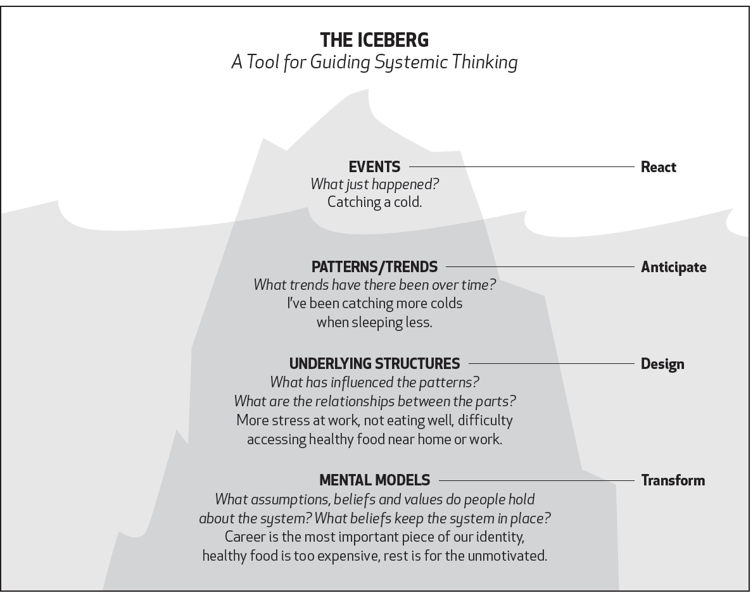

Slide 10
The Parable of the Boiled Frog
As the temperature rises from 70 to 80 degrees F., the frog will do nothing. In fact, he will show every sign of enjoying himself. As the temperature gradually increases, the frog will become groggier and groggier, until he is unable to climb out of the pot. Though there is nothing restraining him, the frog will sit there and boil. Why? Because the frog’s internal apparatus for sensing threats to survival is geared to sudden changes in his environment, not to slow, gradual changes.
…Learning to see slow, gradual processes requires slowing down our frenetic pace and paying attention to the subtle as well as the dramatic.

Slide 11
The Delusion of Learning From Experience
When our actions have consequences beyond our learning horizon, it becomes impossible to learn from direct experience.

Slide 12
The Myth of the Management Team
Striding forward to do battle with these dilemmas and disabilities is “the management team,” the collection of savvy, experienced managers who represent the organization’s different functions and areas of expertise. Together, they are supposed to sort out the complex cross-functional issues that are critical to the organization. What confidence do we have, really, that typical management teams can surmount these learning disabilities?

Slide 13
What are our values?
Timeless and Moral
The criteria for who gets hired, and what gets done: becomes the organizing pattern
We measure ourselves against them

Slide 14
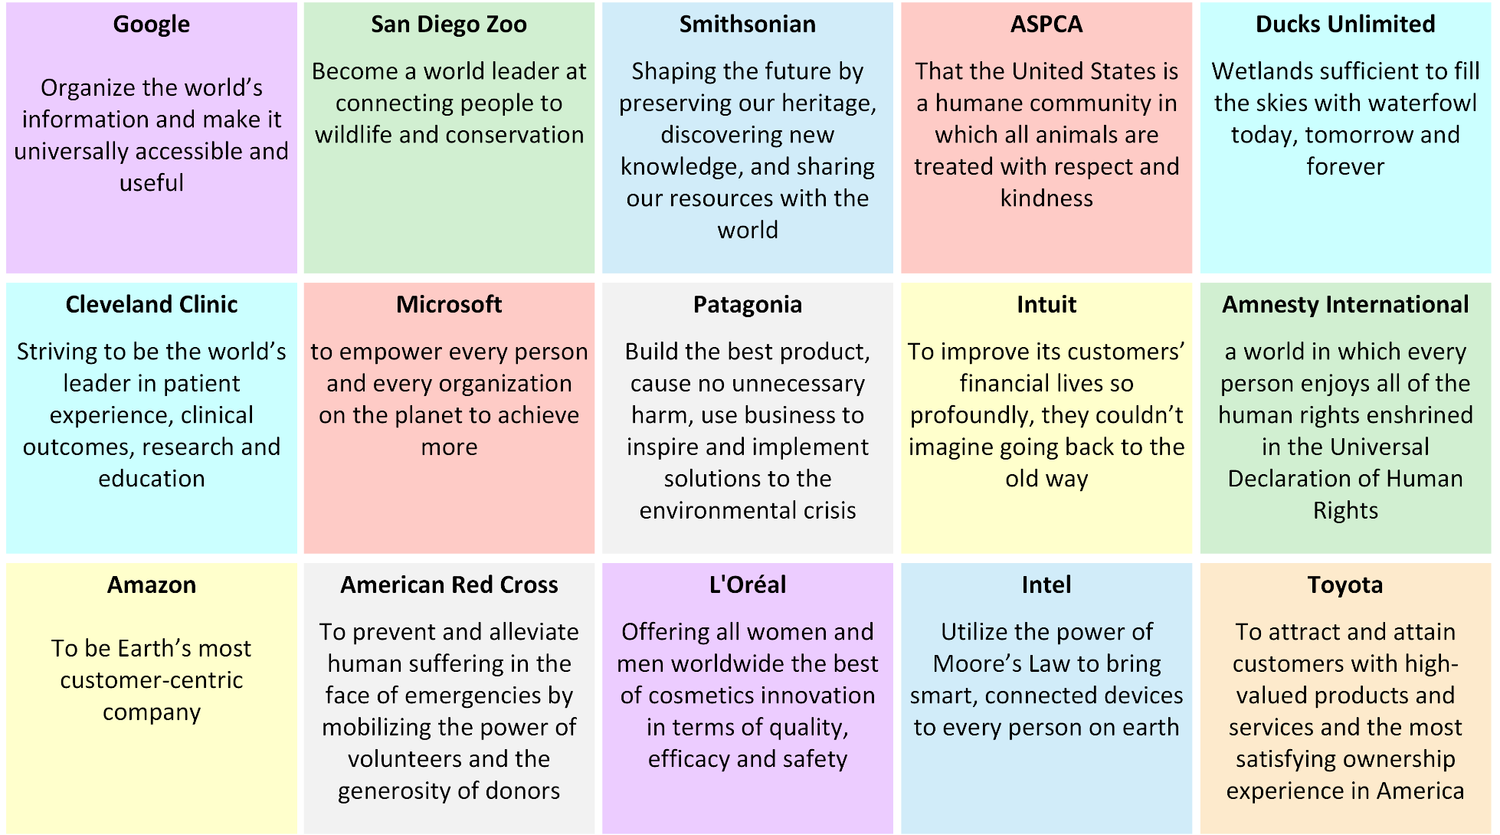
What are our values?

Slide 15
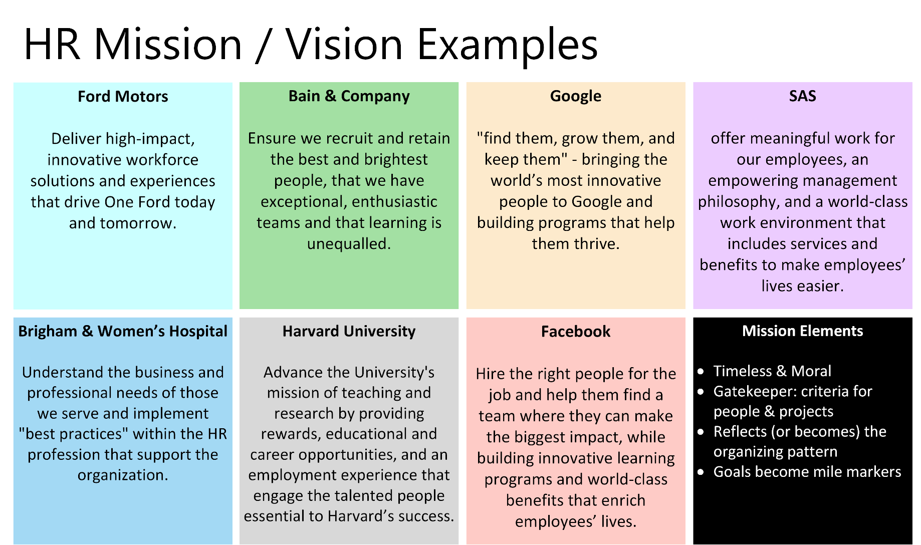

Slide 16
Is it Really Your Value?
The key test –
Values cost us.

Slide 17





How do we measure up?

Slide 18
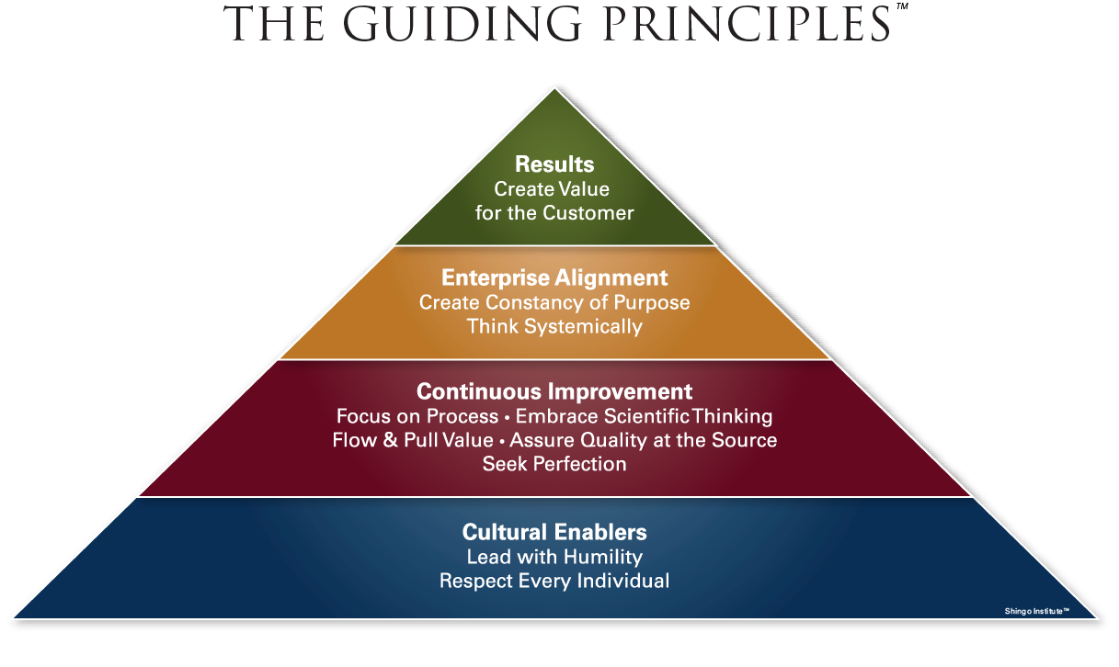
Shingo Institute – Operational Excellence

