Slide 1
Building a Positive and Sustainable Safety Culture

Slide 2
Below 100 Mission:
Reduce line-of-duty deaths to fewer than 100 per year.

Slide 3
The last time annual
LODDs were below 100
was 1943. (94)
Source: Officer Down Memorial Page (www.ODMP.org)
Notes:
It has been more than 70 years since U.S. LODDs were below 100.

Slide 4

5 Tenets
Wear your seatbelt.
Wear your vest.
Watch your speed.
WIN: What' s Important Now?
Remember: Complacency kills!

Slide 5
Predictable is Preventable
Gordon Graham
Notes:
Gordon Graham is a 33 year police veteran, attorney and risk management consultant. Co-founder of Lexipol.

Slide 6
Safety First?
“One by one, 3 utility workers descended into a manhole. One by one, they died.”
“Electric line workers listed among top 10 most dangerous jobs”
“Houston Utility Worker Killed In Electrocution Accident”
“Longtime Utility Worker Dies In 'Freak Accident‘.”

Slide 7
Safety First?
“30 to 50 per 100,000 workers killed annually. That’s twice the fatality rate of police or fire.”
Paul Mauldin

Slide 8
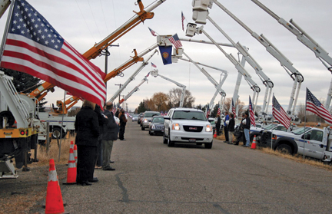
Police or Utility?

Slide 9
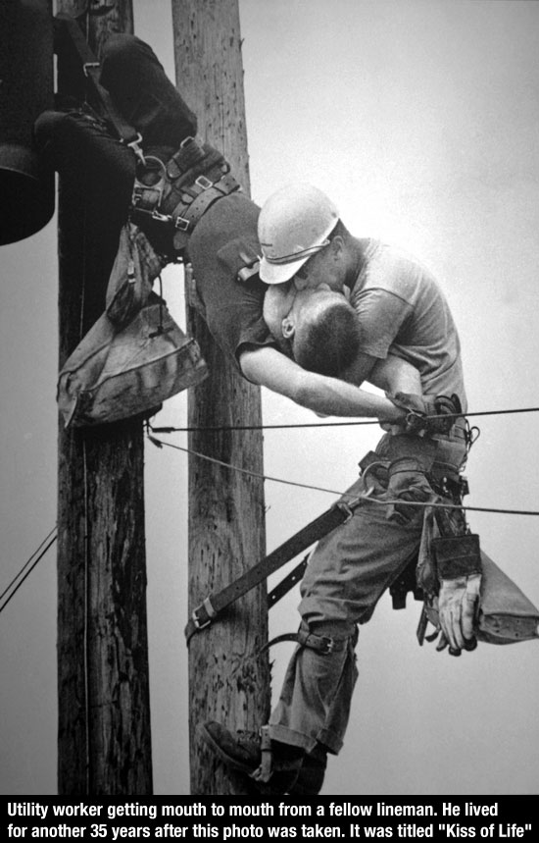
Firefighter or Utility?

Slide 10
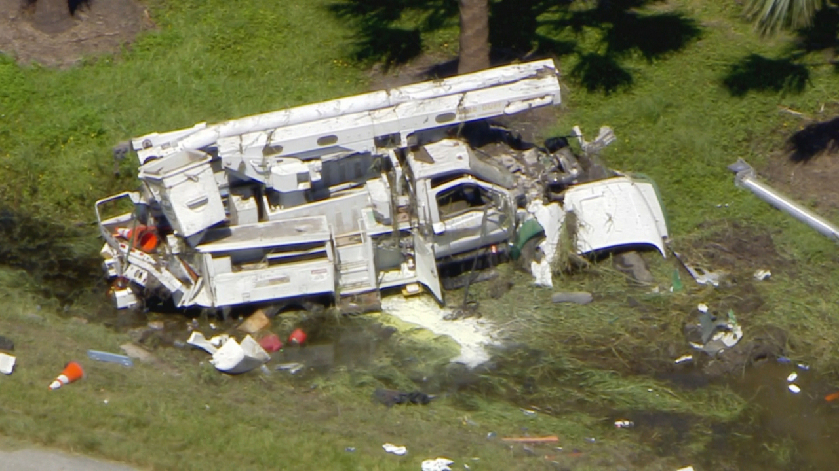
Police, Fire, or Utility?

Slide 11
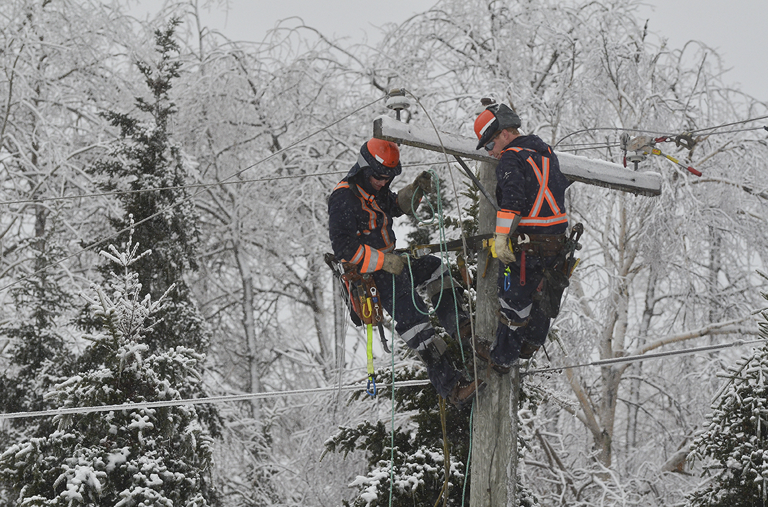
Who works in the most dangerous weather?

Slide 12
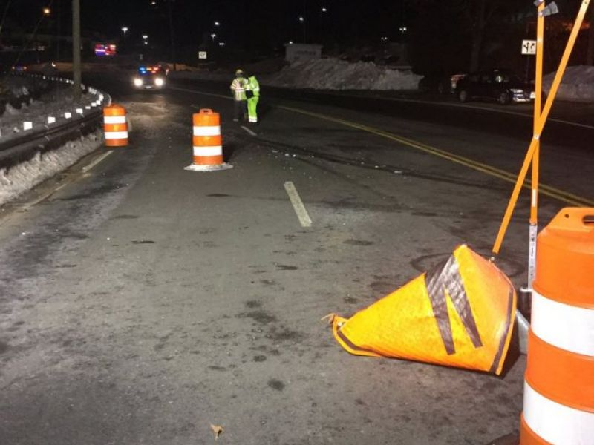
Who dies on our roadways most often?

Slide 13

Who relies on partners the most often?

Slide 14
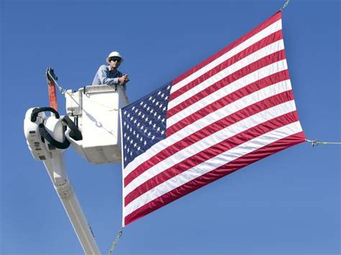
Who is most responsible for serving our citizens?

Slide 15
The Beginning
The NA and Kim
1-1-2016 Supervisor Training Launch

Slide 16
Integration to Training
FTO Program
EVOC Program
Essential Skills Training
Supervisor Training
Below 100 Roll Call Training
Near Miss Roll Call Training
Below 100 Spouses Training
Dispatch Center

Slide 17
CHANGING AGENCY CULTURE

Slide 18
Changing Agency Culture
Pursuit Policy
- Decrease pursuits through training and education
- Increase direct supervision
- Better define need for a pursuit
Driving/Injury Review Board
- Consistency in findings
- Identify training needs
- Identify trends
- Education and support opportunity

Slide 19


Slide 20
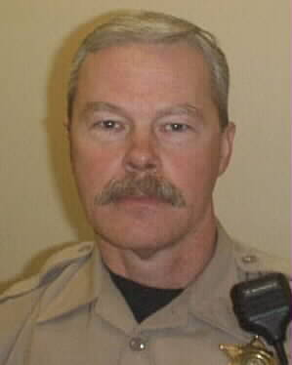
Sgt. Ryan Gausman

Slide 21
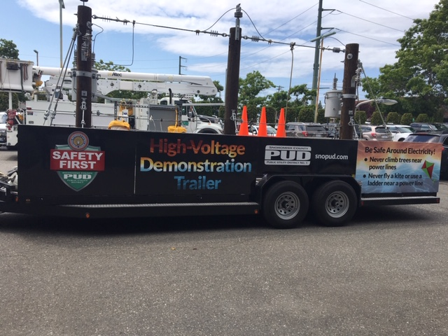

Slide 22
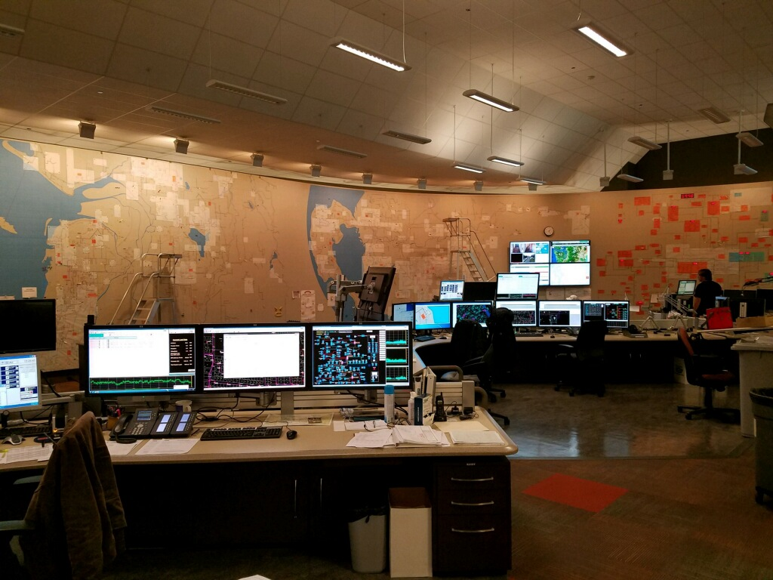

Slide 23
Changing Agency Culture
Telematics – A Powerful Tool
Speed and seatbelt
Overall vehicle operation
Airbag deployment
Emergency locate
Vehicle malfunction
Drivers scoring
Operational advantages
Significant fleet savings

Slide 24

Changing Agency Culture
Promotional Testing
Expenditures
Mission and Goals
AED’s
Upgraded Armor
Upgrade Lighting Systems
Visual
- Posters
- Stickers
- Computer screen
- Data updates

Slide 25
Overview
We drive over 350,000 miles per month
Fully Commissioned Deputies = 300
Personnel = 800
Since 2015:
Average speed of accidents down 50%-70%
The number of pursuits went down ~30%
One significant injury. (Eleven in 2015)
Are we saving lives?

Slide 26
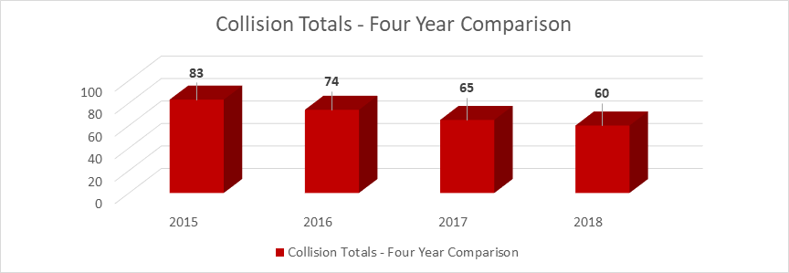
Collision Trend

Slide 27
Does Backing Training Work?

Slide 28
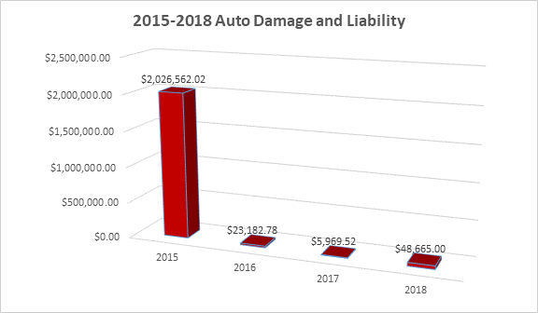
Are we Saving Money?

Slide 29
What’s your role?

Slide 30

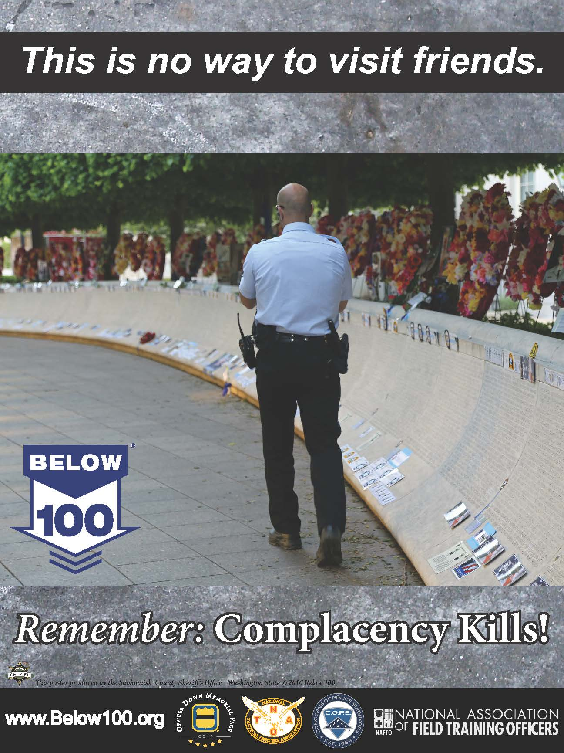
Below 100 Messaging - Ongoing

