Slide 1



Creating a Best Place to Work Where Women Thrive
Tricia Bencich
People Programs Leader

Slide 2
Why Forum W?
Recruit the Best
50%+ of accounting graduates are women
Combat shrinking workforce
Improve Performance
Increase profitability
Foster innovation
Better Serve Clients
Clients and prospects are more diverse
They want to work with others who reflect their diversity and values

Slide 3

Mission
Accelerate the firm’s success in attracting, developing, retaining, and advancing talented women.
Goals
Foster an inclusive culture
Strengthen our pipeline of women
Increase the number of women leaders
Be known as a thought leader

Slide 4

Keys to Success
Understand the real issues
Make the business case
Give women honest feedback
Strive for cultural change
Actually value diversity

Slide 5

Understand the REAL Issues
Don’t just adapt someone else’s program
Gap of women in leadership is not just about work/life balance
Unconscious bias & cultural norms
Role models
Mentorship & sponsorship

Slide 6

Make the Business Case
Do women hold as many leadership roles as men? Or advance as fast as men?
Do we mirror the diversity of our customer base?
Make the business case for women and for men
This is not about altruism, it’s about business results
Demonstrate support at the highest levels
Do we care?

Slide 7

Develop Successful Women
Define advancement opportunities
Identify gaps
Assign effective coaches
Give meaningful, honest feedback

Slide 8

Strive for Cultural Change
Determine what disruptions are necessary to create lasting cultural change
Set realistic short, mid, and long-term goals for cultural change
And do stuff in the meantime
Create resources, programs, and policies to address how to grow & develop women

Slide 9

Actually Value Diversity
Do you believe you will actually make better decisions with a diverse team?
(If not, don’t bother…)
Diversity is meaningless without

Slide 10
Measuring Progress
Forum W is not an overnight solution.
Short-term (2009–2010) | Mid term (2011–2013) | Long-term (2014–BEYOND)
Activity | Satisfaction | Metrics
Launch Forum W Generate interest and participation Socialize the business case | Mentoring they receive Networks (internal and external) Expanding networks Increasing dialogue | Retention and advancement Embedded in our culture

Slide 11
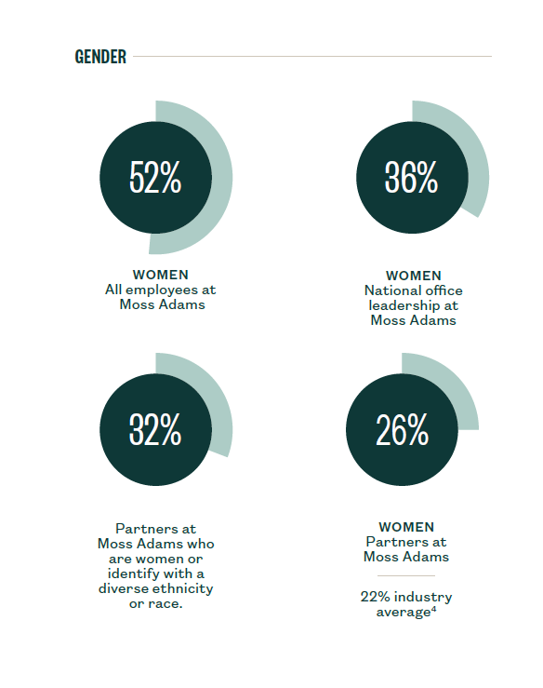
Our Results

Slide 12
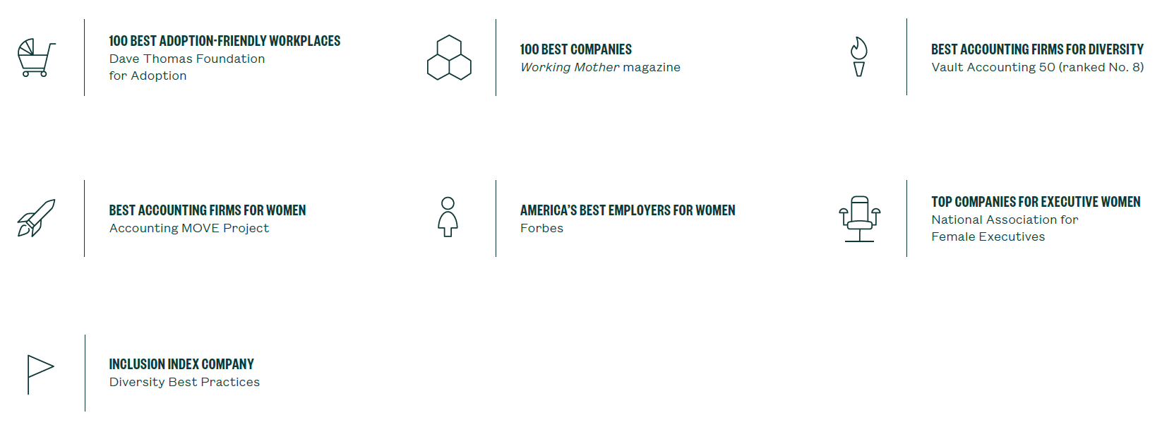
Best Place to Work

Slide 13
Keys to Success
Understand the real issues
Make the business case
Give women honest feedback
Strive for cultural change
Actually value diversity

Slide 14
Questions?

