Slide 1
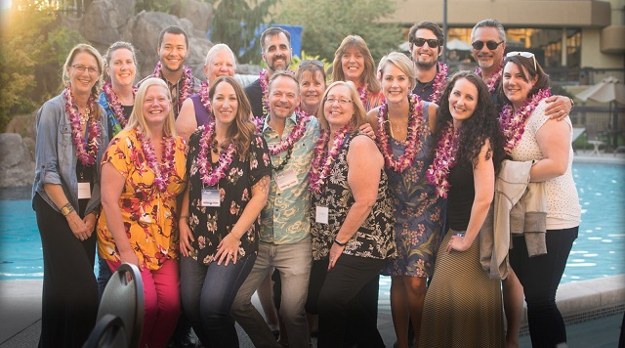








Building a Best Place To Work
(On a shoe-string budget!)
Presented by
Cami Hanson
COO
Amy Trosine, SPHR, SHRM-SCP
HR Manager
2017 Washington Leadership Summit

Slide 2

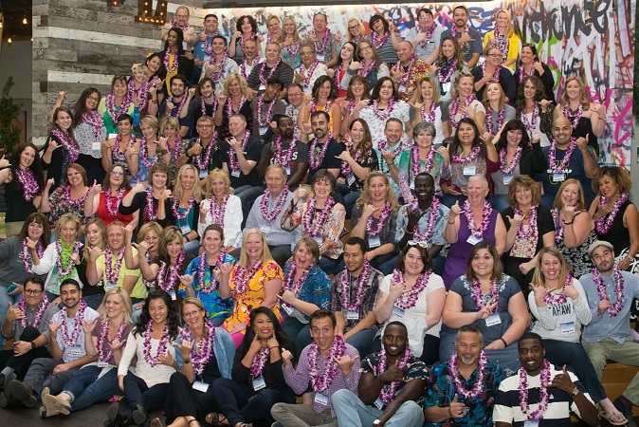






Career Path Services
Who We Are

Slide 3
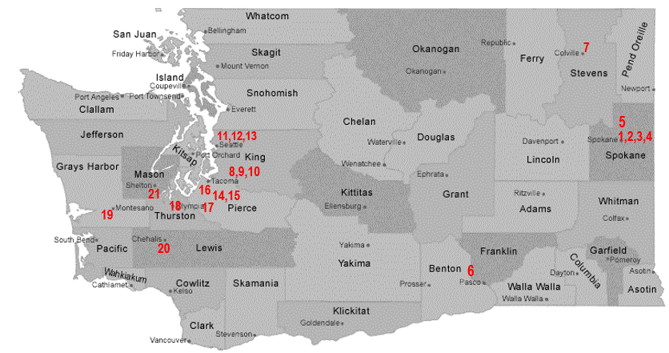
Who We Are
Now 22 locations!
Private, non-profit corporation providing workforce development services to individuals and employers in Washington State
Since 1971
Notes:
Career Path Services is a workforce development organization. Our mission is to help people develop their skills, attach or reattach to the workforce and be able to provide for themselves and their families, we help employers connect to the skilled workforce they need for their businesses to thrive and grow.
In 1971 we began providing services began in Spokane, WA. Our first job training programs were aimed at drop out youth and low income adults, running work crews to clean up the rail yards in preparation for the Wolds Fair and what is now Riverfront Park. Since then we have grown to serve a variety of populations in 22 locations serving Washington State.
We receive funding under the Department of Labor, Department of Social and Health Services, Department of Commerce and private foundations.

Slide 4
Our Vision Statement states what we do now, will do in the future, and how we do it.
Empowering People
Enhancing Workforce
Enriching Community
Our Purpose:
“Breaking the spirit of poverty through the dignity of work”
Notes:
Empowering People: to Empower is to give someone authority or power to do something, make someone stronger and more confident we connect our customers-workers to hope for their future so they can move forward.
Enhancing Workforce: to increase or improve in value, quality, desirability-we connect employers to the talent they need for their business to grow and thrive.
Enriching Communities: improve or enhance the quality or value of, to make fuller more meaningful- we develop the talent pipeline so workers and business have the skills to compete, generate wealth for themselves, their families and their businesses making their communities a better place to live and work. IMPACT
Breaking the spirit of poverty, through the dignity of work
Break: to interrupt, separate or cause to separate
Spirit: the general atmosphere of a situation and the effect it has
Poverty: the state of one who lacks, often associated with money but we do not limit our definition-it can be any lack time resources, access
Dignity: the state or quality of being worthy of honor or respect
Work: activity involving mental or physical effort done in order to achieve a purpose or result; mental or physical activity as a means if earning income.
We do not see poverty as a character issue.
We hire people who connect to the mission vision-Who have a directed passion to serve.

Slide 5
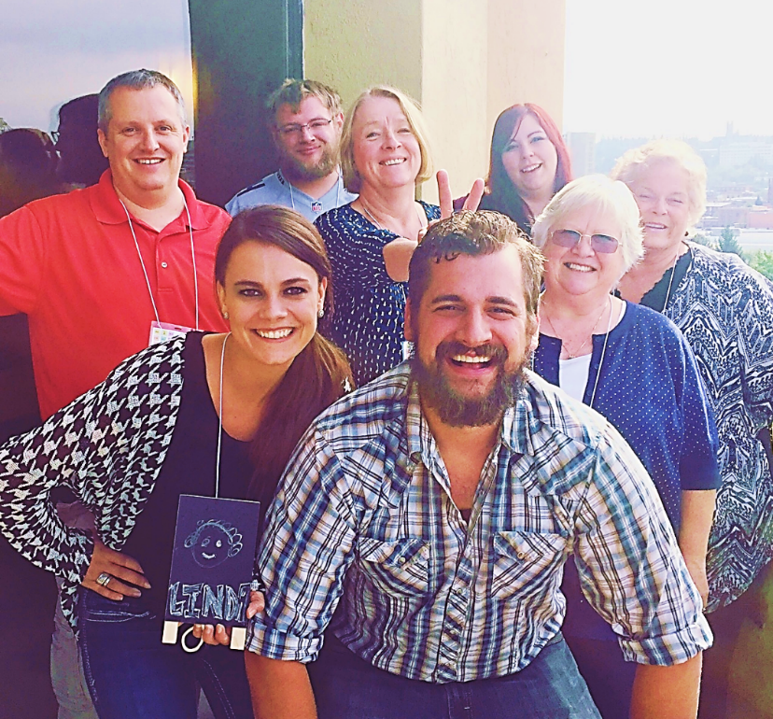
Who We Are…
Guiding Principles
Our “E” Words
Hospitality
Notes:
Guiding Principles:
Leadership Team and BOD are committed to providing all employees with a progressive, productive and friendly work environment.
We strive for the highest level of performance excellence in all we do.
We value our team-based environments. We equally value the initiative and creativity of individuals
We are committee to training and development of employees, life long learning, and leadership development. Together, we are accountable in the quest for competency.
We want long-term, merit-based relationships with our employees. Demonstrated performance success is recognized and rewarded.
We continually strive to be a national leader in employee compensation and benefits.
As an organization we value our three E’s; entrepreneurial, exceed, and excellence. We seek individuals who have demonstrated experience of high performance. We look for characteristics of an individual who wants to continue training and development, lifelong learning and leadership within our organization. We look for patterns of team work and evidence of successfully contributing to a team on a unit level and organization level. We seek individuals who understand and desire to be a part of our corporate mission and vision statement.
The “3 Fs” – Food, Fun, and Fellowship. When we get together we have food! We work hard, but we play hard. We value the opportunities to connect with each other.

Slide 6
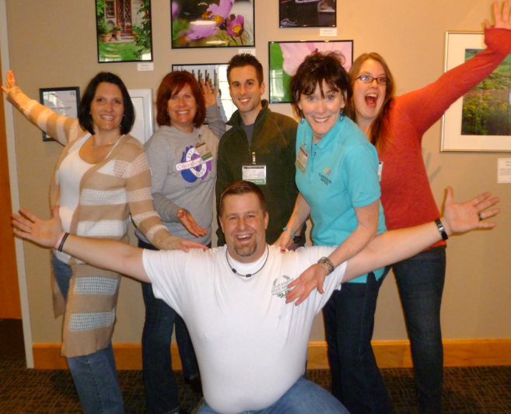
Who We Are…
Leaders
Focus, Faith, Fire
Work hard/Play Hard
Notes:
We are leaders in our field. We innovate and always look for ways to improve. We believe in an effective and flexible workplace for our staff. We strive for excellence, but stop to celebrate and have fun along the way.
We have a focus to provide services that will have a great impact on people and their communities. We have faith in our mission and in our abilities. We have a fire in the belly, without this passion we can’t sustain.

Slide 7



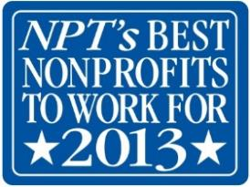







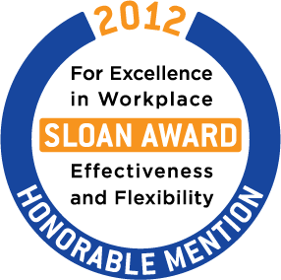
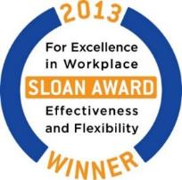



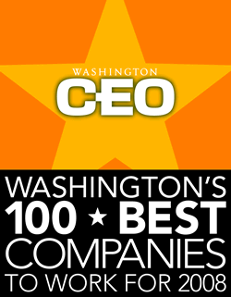

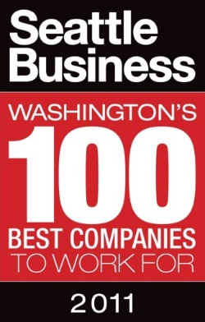
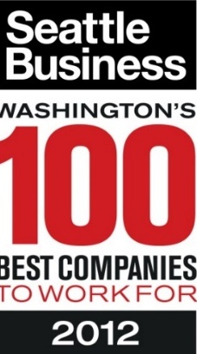


Awards
Notes:
Continuous Quality Improvement
Participate in award surveys – use your feedback to make things better

Slide 8
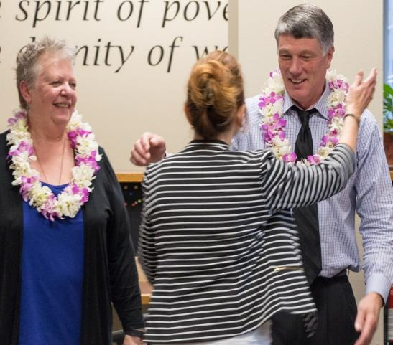
Building a Best Place To Work
From the very beginning
Culture Infusion
Open Door/Open Mind
Notes:
Recruitment – we hire nice people! From the beginning we set the standard of communication, keeping applicants informed every step of the way. We have a multi interview process which can include meeting with the team you would be working with. We hire for fit and train the skills. We look for characteristics of an individual who wants to continue training and development, lifelong learning and leadership within our organization. We look for patterns of team work and evidence of successfully contributing to a team on a unit level and organization level. We seek individuals who understand and desire to be a part of our corporate mission and vision statement.
Most staff work in co-located environments-government offices where they may be the only Career Path Services employee we work. Providing comprehensive training plans and an infusion of culture with a visit to headquarters office in Spokane. New staff have the opportunity to spend a day and a half learning policies, procedures, culture, and history. They also spend an hour with each senior manager and our CEO specifically, identifies what they can expect from Career Path Services. He doesn’t come into the board room with a PowerPoint and stand at the podium but each new employee is welcomed into his office. Once a new employee heads back to their location they have a bag filled with goodies…Career Path Services corporate clothing, coffee mugs, pens, planner and whatever the last giveaway item was at the last all staff retreat.
Hospitality is extended as each office hosts a welcome wagon. Time for the team to get together and experience our 3F’s: Food, Fun, and Fellowship. Typically the welcome wagon is potluck style with a fun ice breaker and food. It is a great way to introduce our newest employees to our organization culture because all throughout the organization we practice the 3F’s.
From the day an employment offer is made to the day a new employee arrives planning begins to take place. A training plan is developed that includes every detail such as introductions, office details, policies, procedures, unit training, and an itinerary to travel to the headquarters office. To the best of our ability by the first day of their employment a new employee will need to proof their name tag, name plate, and business cards. Instantly, our new employees feel welcomed and a part of our organization.

Slide 9
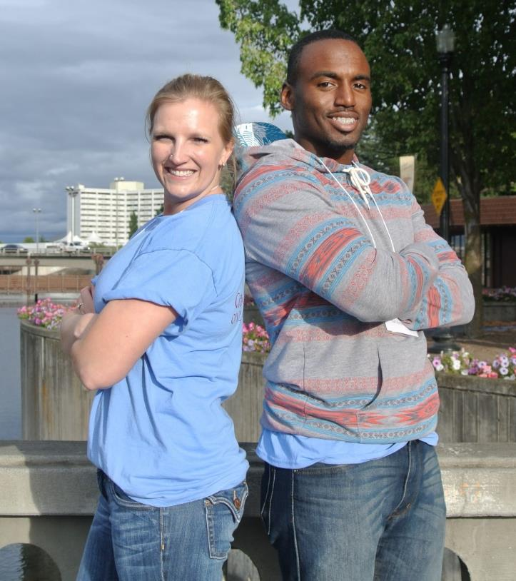
Fringe Benefits – (Tier 1: the Big Stuff)
Competitive Pay
Awesome Insurance
Incredible Retirement
Notes:
Tier 1 benefits are not a no-cost option, but we believe that this investment contributes to the organizations success and the well being of our staff. We call these the golden handcuffs. We want our employees to dedicate their career to the mission of the organization, to do that they need to be cared for and by doing this for our employees they will be to help their customers recognize great places to work with family supporting wages.
We keep an eye on our budget, but we look for ways we can be as generous as possible.
81% of staff contribute their own money. We provide retirement education in NEO and other times of the year.
Competitive Pay and Benefits
Perform Salary Surveys
Health – 3 options
Employee coverage 100% paid
Dental, Vision, Basic Life Ins/AD&D, LTD, STD
Voluntary Benefits
Life Ins, Accident, Critical Illness, Hospital Indemnity, ID Theft, Legal
Golden rocking chair: Retirement: big employer contribution! 7%/10%
Discount Mall

Slide 10
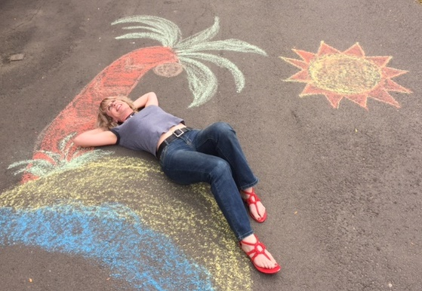
Fringe Benefits – (Tier 1: the Big Stuff)
Generous
Time
Off
Notes:
Generous leave package, as a new employee a staff member accrues 12 hours of vacation leave a month. After four years of services it increases to 16 hours a month. (This is in addition to 11 paid holidays a year.) Each month staff members earn 8 hours of sick leave.
Generous Time Off
Vacation 12 or 16 hrs/mo from Day 1, use as soon as accrued
Sick Leave 8 hrs/mo, use as soon as accrued
Sick Leave Pool
10 Holidays plus Floating Holiday
Paid Early Release – Winter Holidays
Paid Bereavement – no waiting
Paid Military Training Leave
Paid Jury Duty

Slide 11
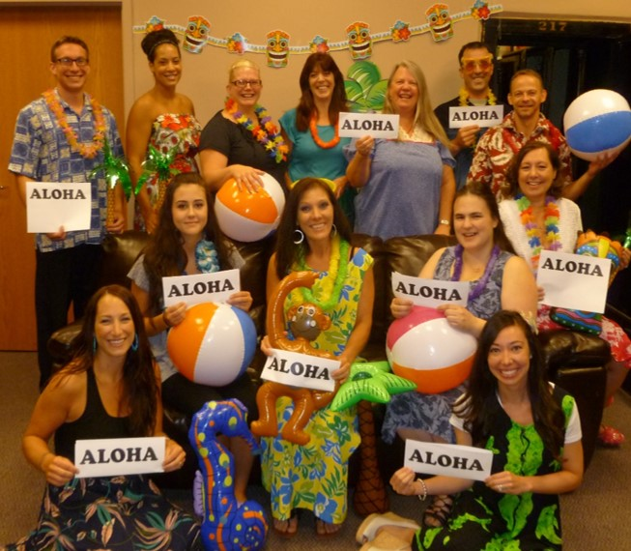
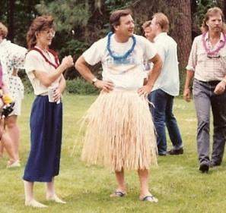
Fringe Benefits – (Tier 2: the FUN Stuff)
Paid Parking
Cell Phone Reimb
Relaxed Professional Dress Days
Office Snacks
Great Discounts
Notes:
Our Tier 2 benefits are ones we chose to offer our employees, they tend to be low cost with high return
Paid Parking or Bus Pass
Cell Phone Reimbursement - $40/$75 per mo
Mileage Reimbursement (GSA rate)
Roadside Assistance –regularly travel >50 mi
Aloha! Relaxed professional summer dress
Budgeted office refreshments and snacks
Managers – laptop/internet access reimb.

Slide 12
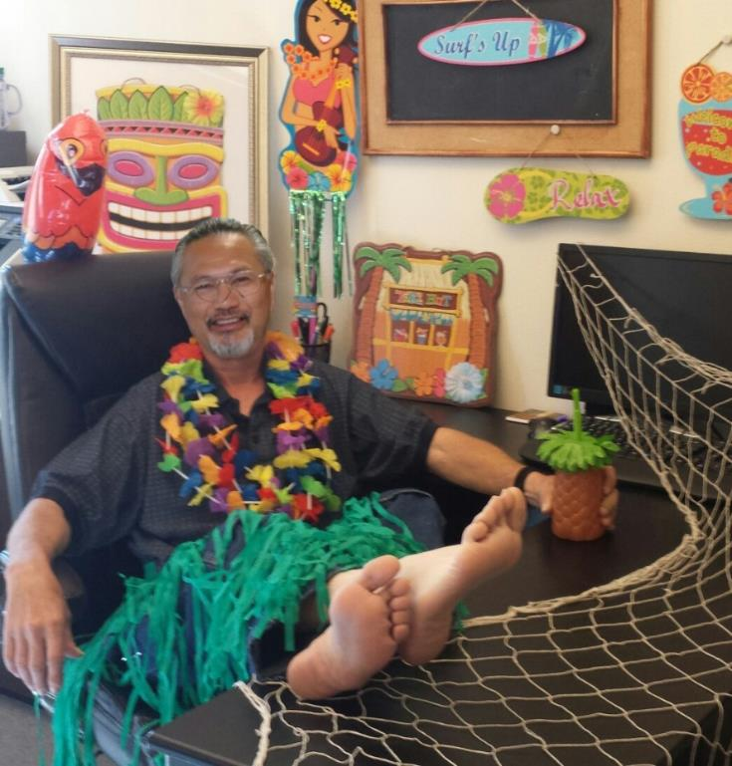
Encourage Wellness and Satisfaction (more Tier 2: FUN Stuff)
Work/Life Satisfaction
Personal Development
Notes:
Our families are often a part of our work events. For example, each year we host a Bloomsday Corporate Cup breakfast which our CEO prepares and serves. All employees and family are invited to attend and cheer on their family members who are participating in Bloomsday. During our winter holiday season we have had many employees invite their spouse and children to be a part of the events such as caroling, gift giving and Thanksgiving dinner.
We know that healthy employees are productive employees, and are able to better serve our clients. Juggling work and our personal lives can be difficult some times and a “balance” may not occur because our home and work priorities are constantly shifting. We want our employees to have a work/life satisfaction, and encourage our staff to stay at the 40 hour work week.
Personal Development Reimbursement
Whole Person Focus: body/mind/spirit
Gym dues, exercise equipment, self-help materials, career development, race fees
Health plan – mental health/chiro/massage
Float Holiday – mental health day
Paid CPR/1ST Aid training
40 hour work week – work/life satisfaction
Families first!

Slide 13
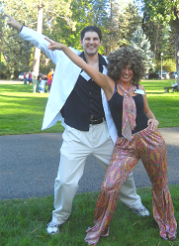
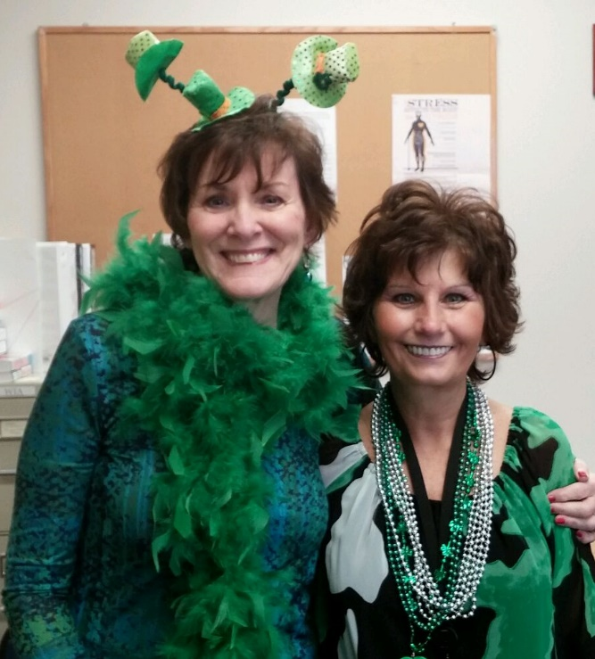
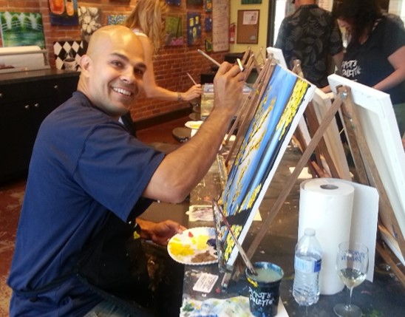
Flexibility
4 Day Work Week since ‘79
Flexible work options
Notes:
We offer flex start times within a start time requirement, it has assisted many employees with instances that “come up” the morning of and still allow them to be on time for the work day yet cater to the needs of their family. We do not have many restrictions on lunch breaks. Employees are allowed to take their lunch within a two hour period and can take a half hour or hour lunch. For some employees they visit the gym during the lunch and are able to go to the gym when the typical lunch crowd is just finishing up.
4 Day work week since 1979
Work 5 days if it meets your needs
Flexibility outside Core Hours
Work from home

Slide 14
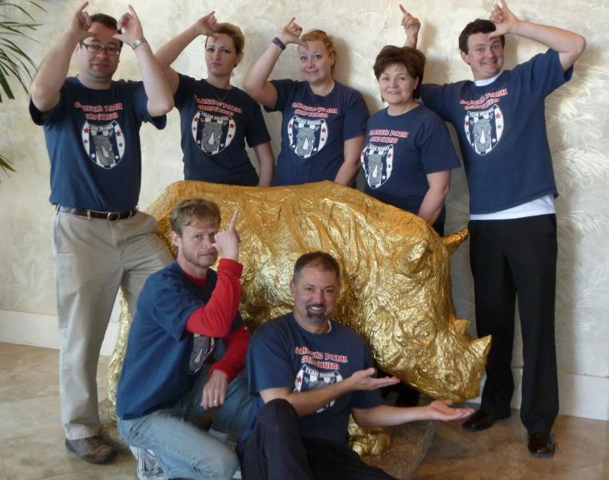
Communication
Transparency
Message Kits
Employee Involvement
Seek Feedback
Kill That Stupid Rule!
Notes:
We value transparency and deliver many message kits. As we approach constant change, growth, and demand we are continuing to package message kits to the entire organization. These message kits are all organization announcements that communicate to all staff “what is going on” with a consistent message. The message kit helps to prevent any unknown about organization wide activities specifically in regards to organization changes or on-going projects.
Each year as an organization we have two annual staff two day gatherings. We focus on the Three F’s: Food, Fun, and Fellowship. As an organization we meet offsite at a center away from the business for two days. Day one of the retreat we have specific “pre-events” for each unit that applies principles, best practices, and encouragement for the entire unit. In the evening, all units come together as an organization. Last year was a Hawaiian Luau! Day two of the conference is filled with training for the entire organization. We open the day with a member of senior management providing our state of the agency address. The day is filled with training, recognition of staff and unit achievements. Both days are filled with food, fun, and fellowship! Our annual staff gatherings are an opportunity to stop and reflect on our achievements, reenergize, and rededicate ourselves to our mission and vision.
Employees are encouraged to ask questions, provide feedback, and communicate with the entire leadership team by any means of communication. Our organization practices an “open door policy” and by open door our organization means “open mind”. Our organization is very specific that our management and employees have an open mind to all things possible.
Each year we have organization surveys to gage how our employees are feeling in regards to work satisfaction, health benefits and compensation. Survey results are published to all staff and trends are addressed as an organization. Committee’s are often time a great way for an employee to be involved in the decision making, suggestion or direction of a possible organization change. For example, our staff has asked for more professional development opportunities and we are in the process of creating a committee to lead this mission. At our last all staff gathering we began our organizations strategic planning process together. Our leadership team realized the importance of involving all staff in the decision process of a commitment such as our strategic planning process.
As for an undesirable situation we train and encourage each of our employee’s to begin with informal resolution. If a situation is still undesirable a supervisor, EEO officer, or a member of senior management can assist with the process. As a part of our employee evaluation process employees have an opportunity to disagree with supervisor ratings and discuss
Trust, compassion, stability, hope

Slide 15
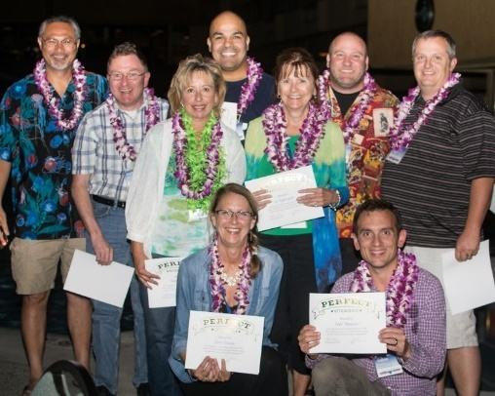
Career Development
CPSU
Community Involvement
W.O.W.
What’s CPS Reading?
Notes:
Throughout the year, employees have the ability to ask their supervisor for relative training specific to their area of expertise. There is no set budget for this training and has final approval from the CEO. Employees have attended training such as accounting, event planning, and communication.
Employees are encouraged to join community and national associations relative to the organization and their career. Currently, our organization has employees that serve on local boards and committees. We encourage community committee work, such as Local Planning Area groups for services to welfare recipients, Chamber of Commerce meetings, Greater Spokane Incorporated meetings, INSHRM meetings, disability advisory groups, and industry specific associations to name a few.
Senior management and management staff are given paid professional leave and paid professional development reimbursement for up to a certain dollar amount each year. It can be used for books, DVDs, and/or other training seminar developmental tools. Annually the senior management and cabinet management team get together offsite for their annual Cabfest. It is an opportunity for them to realign as a team and kick off the next fiscal year.
Talking stories –share our successes and our client successes
Promote employee’s work in their communities – ex. Helped an employee organize a 5k run
Corporate Training with Industry Specialists
Division Spring Training
CPSU
Community Involvement
Boards, leadership groups, GSI, Chamber, other NPs
Certifications paid
Personal Development Reimbursement
What is CPS Reading? – Book order for all
Story-Telling – employee and customer successes
W.O.W. - Words of Wisdom, Words of Wonder

Slide 16
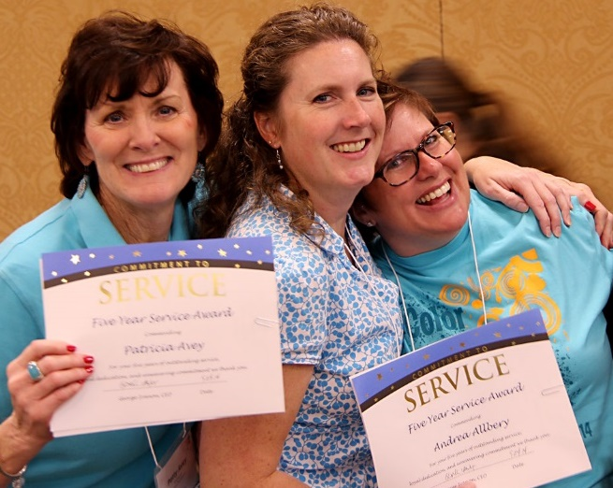
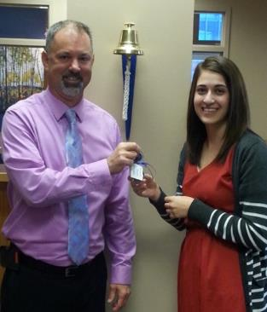
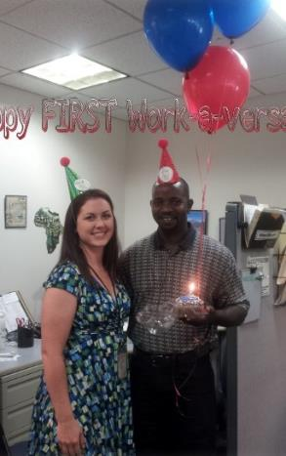
Employee Recognition & Celebration
Ring the Bell
Celebrate!
Random Fun
Awards
Notes:
We celebrate our employee achievements and goal attainments at our annual Fall Conference. Our monthly Ring the Bell award goes to an employee nominated staff member who goes above and beyond. When a customer gets a job, we ring the bell in our office. Each division and team sets awards meaningful to them. We love giveaways, and use gift cards to show appreciation. Our Bank of America credit card generates points we can redeem for gift cards. When the team or the company experience success, we encourage and provide for random and unscheduled fun treats. For example, we recently won the Non Profit Times Best Place To Work For Award (for the 5th year in a row) and gave the staff thank you cards signed by the management team. We provided a $ amount to the managers and said “Go celebrate with your team!”
We provide our managers with an annual budget for team employee recognition. Many of our teams celebrate the end of program year in fun ways. One team goes down to the big fountain in Riverfront Park in Spokane and jumps in the fountain with their clothes on! Our teams make great videos of how fun we are….
Annual Awards
Ring the Bell
Division and Team Awards
Giveaways, Gift cards! (use credit card w/ benefits)
Managers budgeted $ for employee recognition
Celebrate! Random/Unscheduled fun treats
End of Program Year Celebration

Slide 17
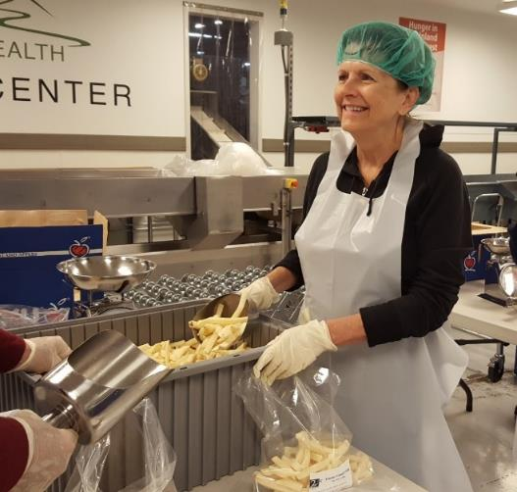
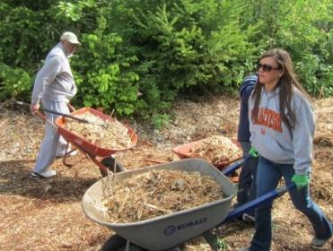
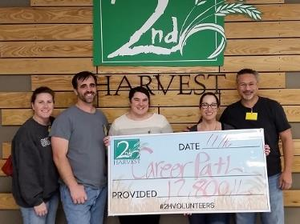
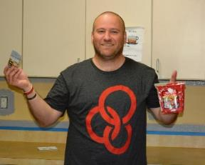
Giving Back
MADD
Work with our hands as well as our hearts
Notes:
As an organization, we pride ourselves in being a part of our community and truly enriching the community we work in. Annually in the spring each office of Career Path Services collaboratively volunteers part or all of one day to Make a Difference in their community. Each office designates an event for the office to voluntarily participate in. Committees are formed for each location and the committee determines the need for the staff to work with the community for a philanthropy event. We have five different events going on in the state of Washington. Each event is uniquely different to the needs of the community. For example, the Spokane staff worked with helping Habitat for Humanity build homes while the Colville staff worked to weed wack an entire field to assist with clearing the brush for a green home project to be built.
As an organization we also provide financial contributions to efforts supported by our employees and board members. Such examples are the Medical Lake Tennis-athon (which raises money for social services in Medical Lake), Hire Ability Day, Colville fishing derby, Junior Achievement, Colville and Omak Thanksgiving dinners for the community, and more.
Each office location has specific events around the holiday season they give to each year. For example our South King County offices host a winter coat-athon and our Spokane offices adopt seniors from a retirement home and present gifts and carol.
MADD (Make A Difference Day) – any day!
$100/ee/yr plus $500 per team
Charitable Giving
NCCC Holiday Caroling
Align with our core values

Slide 18
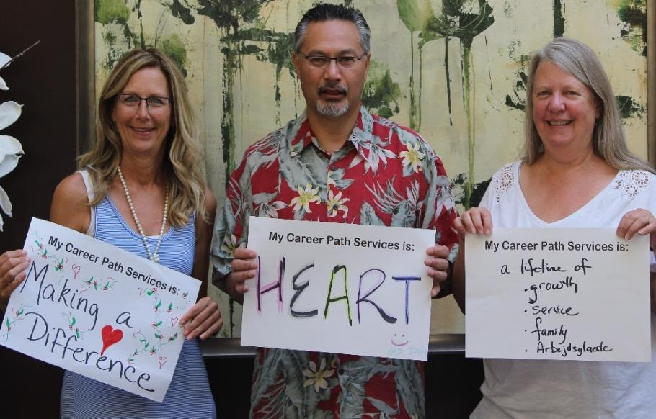
Care and Commitment
Transformational Leadership
2.0
Inspire
Care
Celebrate
Notes:
Our management models a transformational style of leadership. If we experience transformation in ourselves, we are better equipped to serve our customers.
Repair – Restore – Retain, avoid Remove. Address performance issues right away by providing support and training in a variety of ways… specialized training or programs, professionals to assist with employee conflict and communication.
Transformational vs. Transactional
2.0 version of self
Employees=customers – committed to serving them well
Emotional commitment to the workplace
Sr Mgrs Impact
Sit in annual evaluations
Attend employee award ceremonies
Work to improve the workplace experience
Inspire
Care in times of need – find ways to support (flowers, showing up in hospital, make donations)
Celebrate life events – births, adoptions, marriages

Slide 19
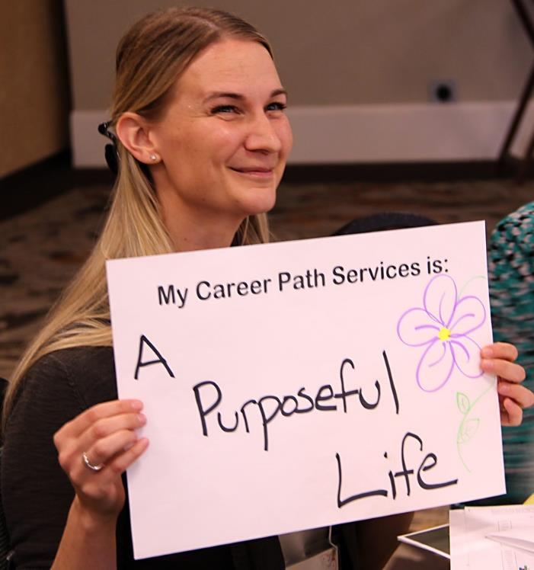
Multi-faceted approach
Leadership
Culture
Satisfaction
Engagement
Notes:
Our approach to a Best Place to Work is multi-faceted. We provide the kind of leadership that helps to transform people into better versions of themselves. We’ve created and sustained a corporate culture that isn’t just about what’s good for the company, but what’s good for our people so they find satisfaction in what they do during their time with us. This is how we increase employee engagement.

Slide 20
Low Cost or No Cost Ways to
Build a Best Place To Work
Extend hospitality
Welcome Wagons
Recruiting/Onboarding Communication
Open Door- Open Mind atmosphere
Relaxed Dress Code
Increase Flexibility
  4 day work week
  Flex outside core hours
Celebrate Successes!
Provide meaningful benefits
  Try Perkspot Discount Mall
Seek Feedback
  Employee Advisory Groups
  Participate in award surveys
Get employees involved in community
  Volunteer/Give Back
  Join boards, leadership groups (take employees with you!)
Communicate
  Variety in message kits
Leadership Dedication & Involvement
  NEO
  Evals

Slide 21
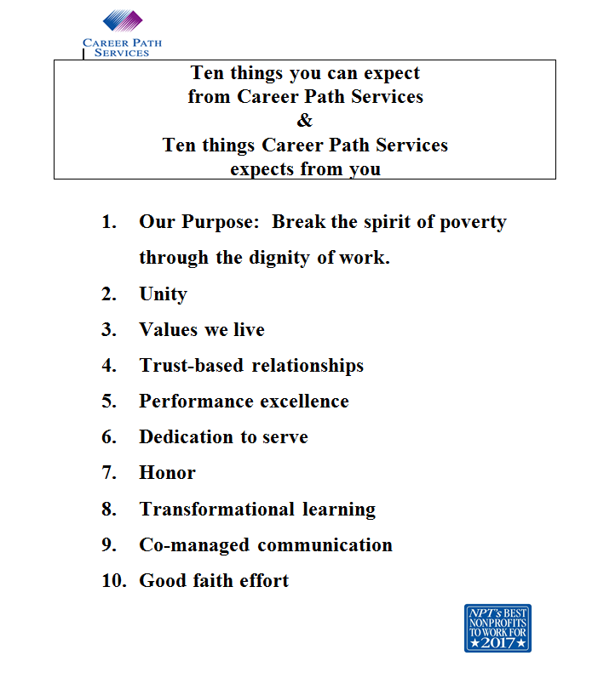
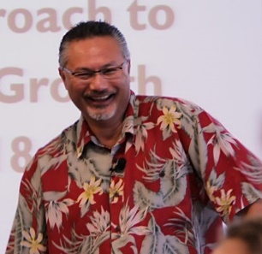
CEO George Iranon
Notes:
Our CEO, George Iranon discusses the “Ten things you can expect from Career Path Services & Ten things Career Path Services expects from you” with all new staff, and revisits this message with our work teams.

Slide 22

Thank you!
Now go out there and help make your organization a Best Place To Work!

