Slide 1
How might we… reimagine culture
Washington Leadership Summit
Jessica Dang, Results Washington
September 26, 2019
Notes:
Helps you reframe challenges into possibilities
Change -
Transform -
Reimagine

Slide 2
40 minutes to make a difference

Slide 3

How might we...
Improve the employee experience?
Put Washingtonians at the center?
Challenge organizational norms?
Notes:
Helps you reframe challenges into possibilities
Since 2013 we’ve had a strong focus on improving the customer and employee experience
The last one - that’s more of a personal curiosity - we’ll go into this in more depth later

Slide 4



How might we improve employee experience?
Notes:
Helps you reframe challenges into possibilities

Slide 5



How might we put Washingtonians at the center?
Notes:
Helps you reframe challenges into possibilities

Slide 6

Challenging Organizational Norms

Slide 7

How might we reimagine meetings?

Slide 8
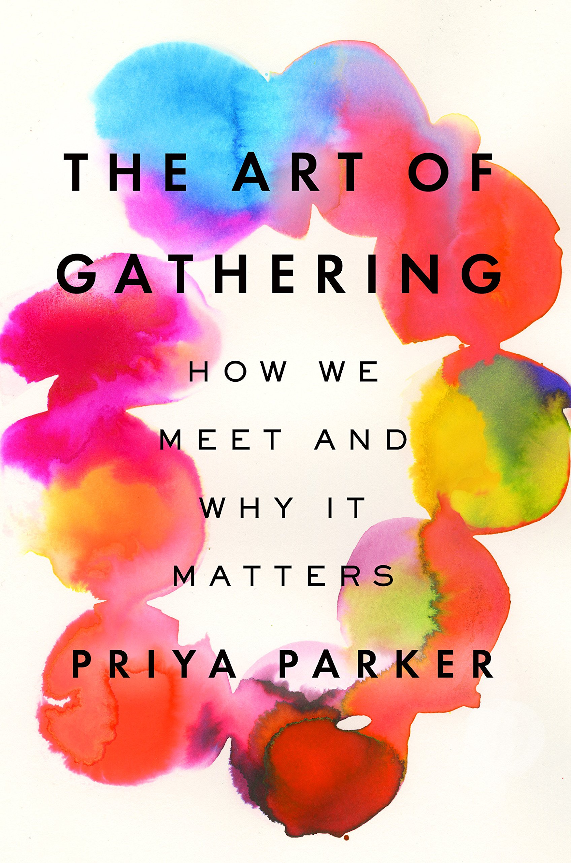
When we do gather, we too often use a template of gathering (what we assume a gathering should look like) to substitute for our thinking.
-Priya Parker, The Art of Gathering
Notes:
Priya Parker - Gathering - the conscious bringing people together for a reason. Gatherings shape the way we think, feel, and make sense of our world....we tend to keep gathering in the same tired ways. Most of us remain on autopilot when we bring people together, following stale formulas, hoping that the chemistry of a good meeting...will take care of itself, that thrilling results will magically emerge from the usual staid inputs. It is almost always a vain hope.

Slide 9
How might we reimagine meetings?
Purpose
People
Process
Place
Participation
Production

Slide 10
Purpose
What do you want to be different when you leave?
Notes:
Design starts here. You can’t create a meaningful experience without knowing what needs to be different at the end.
This step informs the who and how. You can’t start with a vague purpose.
To get to a clear purpose, channel your inner preschooler and start asking why

Slide 11
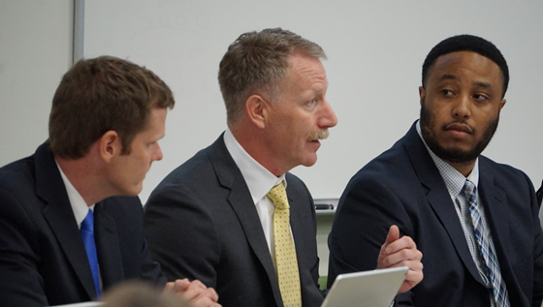
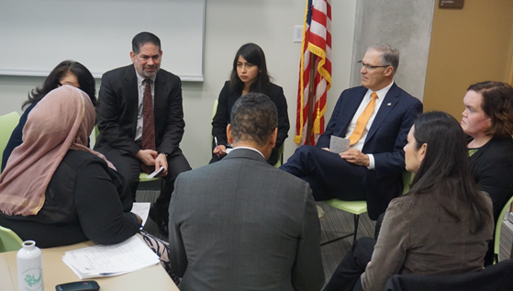
People
Notes:
Who is not at the table? What perspective are you missing? What assumptions are you making? A data point doesn’t equal understanding.
Inclusion - You are welcome here and we are ready for you. Ask attendees! People will let you know.
What you can do to make sure attendees can fully participate in achieving the meeting purpose

Slide 12
Process
What series of actions will lead us to achieving our purpose?

Slide 13
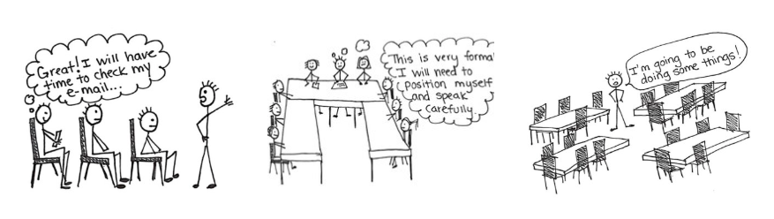
Participation + Place + Production
How might you engage people to achieve the purpose?

Slide 14
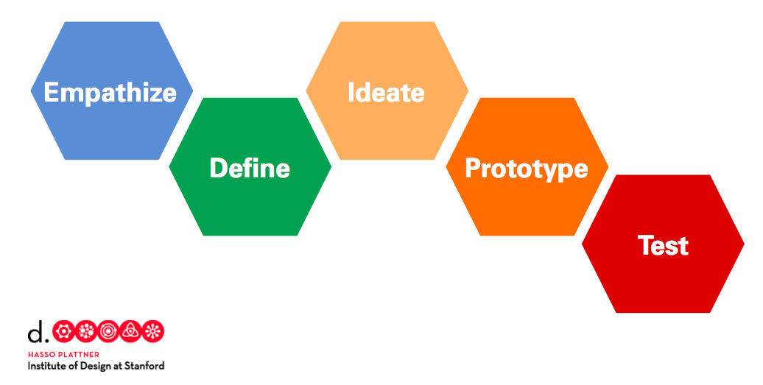
Listen & ask questions
Reimagine
Identify challenges & opportunities
Design
Learn

Slide 15
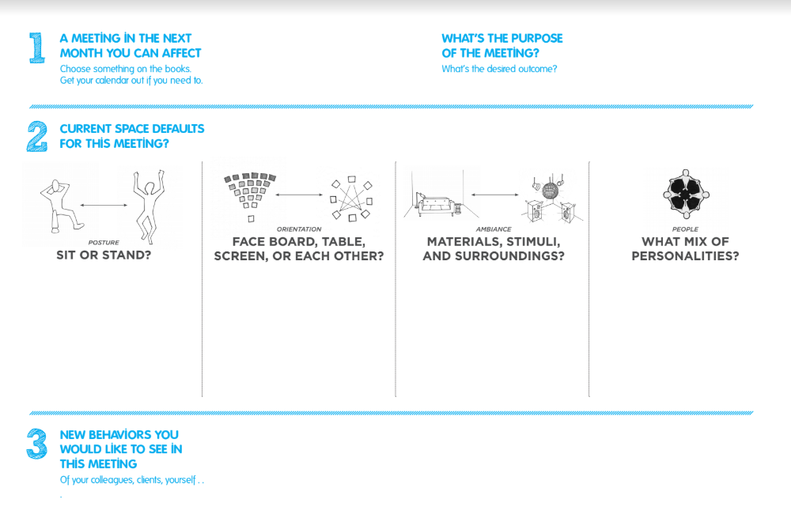
Purpose
Participation
Place
Place+Presentation
People+Participation

Slide 16
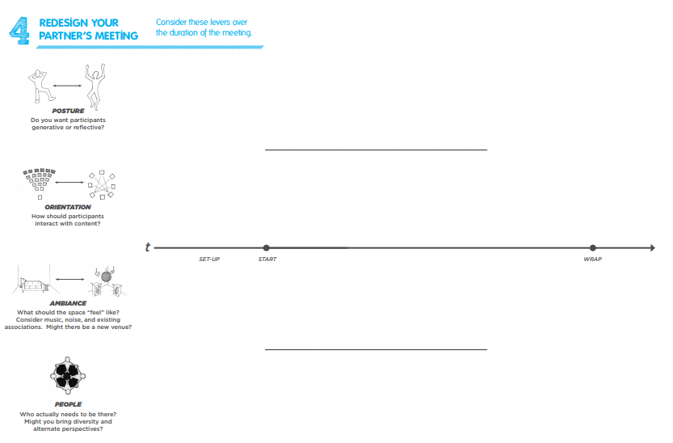
Share first page
ddfdfdf
www
Ask questions, take notes
Redesign!
Share your prototype
Give and get feedback
LEVERS
ddfdfdf

Slide 17
Design Debrief
What did you learn?
What surprised you?
What are you going to try?

Slide 18
If you zoned out...
Turn challenges into possibilites
Start with people and purpose
Curate an experience
Take on norms
Small interventions = big impact

Slide 19
Thanks!
Any questions?
You can find me at Jessica.Dang@gov.wa.gov

