Slide 1



Slide 2
Parker’s Recipe for Success –
A Cultural Perspective​

Slide 3
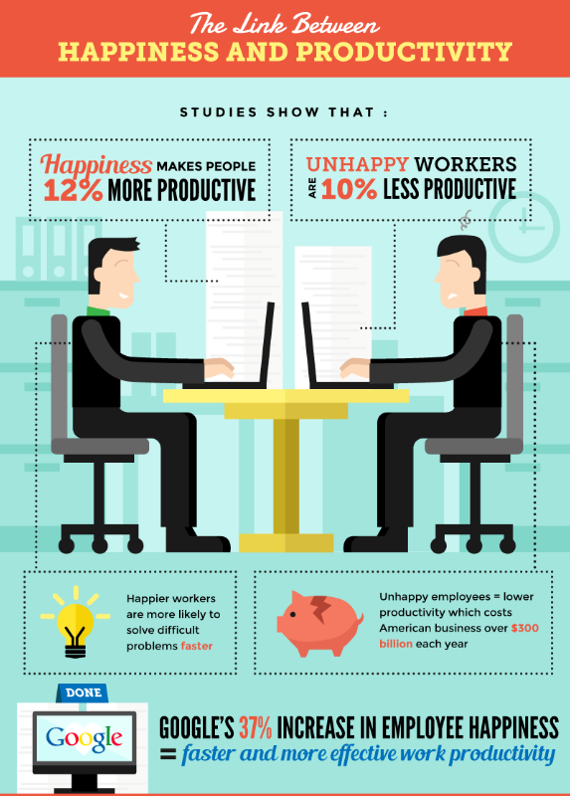
Some Culture Trivia:
How much more productive are happy people at work?

Slide 4
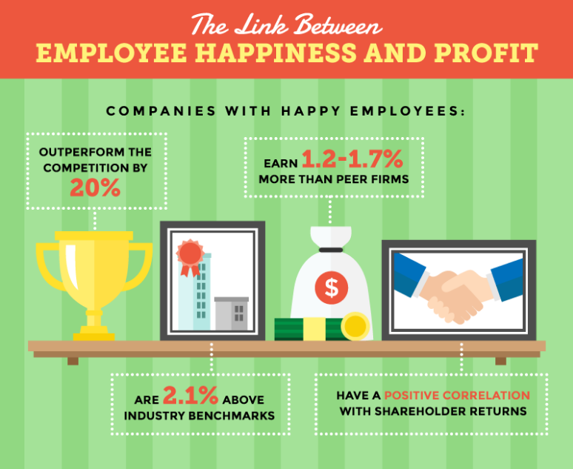
Some Culture Trivia:
Companies with happy employees experience what percentage increase in financial performance over their competition?

Slide 5
A Little Bit About Me:
Katy Riley, SVP
Finance & Administration
25 years of management experience
Both start-up and Fortune 100 sized companies
Exec team member at Parker for over 10 years
Manage the Finance, Accounting, Operations, IT and HR functions
Corp. Culture Influencer & Growth Driver

Slide 6

Agenda
Parker's Chronological Evolution
Parker 3.0 - Our Journey
Culture Values and Beliefs
Parker's Platinum Service
The Ecosystem & Efficiency
The Parker Difference & End Results

Slide 7
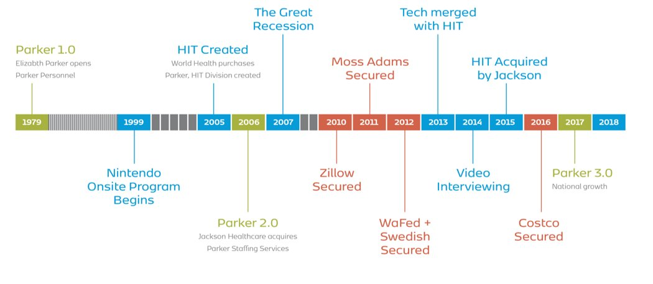
The Evolution of Parker
Top Client Secured
Top Client Secured
Top Client Secured
Top Client Secured

Slide 8

Parker 3.0 Current State
The path to success was asking ourselves these questions:
What can we do to increase our rate of growth?​
Do we have the staff that can scale?​
Do we have the infrastructure to support the vision?

Slide 9
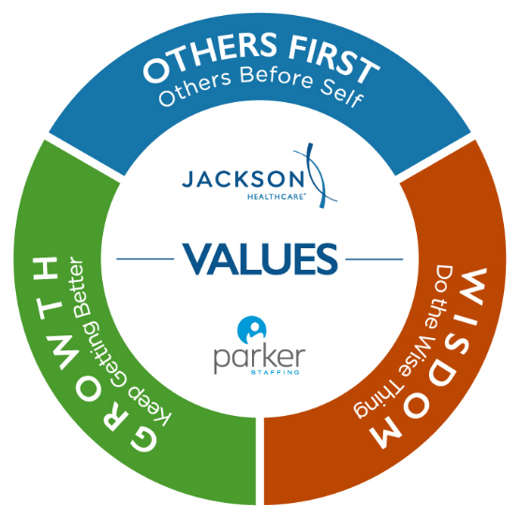
Culture: Values & Beliefs
Vision
Starts with our Mission
Values
Others First, Wisdom, Growth
Practices
Reinforced by our Operating Principles
People
Find the Best & Share the Values
Parker’s Narrative
Keep Sharing the Story
Our Environment
Physical Space. Intention, Collaboration
9
Notes:
Katy add bullets

Slide 10
Culture: Deep Dive
The Recipe for Sustained
Success in 3.0 - Hiring & Training
Clarity & Focus - Talent profiles and who joins the Parker team​
​Training in “The Parker Way“​
Staying the Course & Career Pathing​
Continuous Improvement & Growth
10
Notes:
All of us add bullets. Talk about Clara's role and the training manual
Behavioral interviewing, Top Grading, selecting top talent, DISC, Sandler Sales Training
We hire non-industry people and train them
Recruiters are highly sought after in Seattle

Slide 11

“Our team is small, but mighty. As someone who went from a large, global staffing company to a small, regional staffing company, I can honestly say we hands down treat contractors and clients extremely well.”
Best Staffing Firms to Work For, Staffing Industry Analysts
“Parker Staffing has a unique approach to meeting each individual’s needs.
The firm offers the staff to mentor and develop you professionally...I never felt like I was just a number.”
National Staffing Employee All-Star,
American Staffing Association
“The motto of the recruitment firm’s parent company, Jackson Healthcare, is “Growth, Wisdom, Others First.” And, according to one Parker staffer: “We live by our core values.”
100 Best Companies to Work For, Seattle Business Magazine
“Culture and support is what makes a workplace great. Parker has that. A career path and a purpose is what makes a company great. Parker has that. Benefits help make a company
great, Parker has amazing benefits! It’s the fun times, and Parker has plenty.”
Washington's Best Workplaces, Puget Sound Business Journal
11
Notes:
All of us add bullets. Talk about Clara's role and the training manual
Behavioral interviewing, Top Grading, selecting top talent, DISC, Sandler Sales Training
We hire non-industry people and train them
Recruiters are highly sought after in Seattle

Slide 12

Platinum Service – An Operational View​
The Concierge Mindset –
Obsessed with the Candidate Experience​
Director of Operations, Cory Snively​
Onboarding of Contractors​
Contractor Retention​
Centralization of Administrative Duties – "Let the producers produce.”
Annual average of 1,200 unique W2’s

Slide 13

Platinum Service – Ecosystem Explained
The Concierge Mindset –
Obsessed with the Client Experience​
Better Controls & Smoother Audits
​
Success Defined!
Client Onboarding, Electronic Invoicing & Days Sales Outstanding
10 years of Clean Opinions from outside auditor
99.5% payroll and invoicing accuracy
Avg monthly DSO of 28 days

Slide 14
The Parker
Difference:
Results 40 years
in the making
Strong, Tenured Management ​
Diligence around who we hire​
Dedication to training ​
Responsive, Centralized Recruiting Structure​
Efficient Administration
Accuracy and Operational Excellence​
Business Development Strategy
Based on Partnership and Growth​
An Inclusive and Diverse Culture

Slide 15
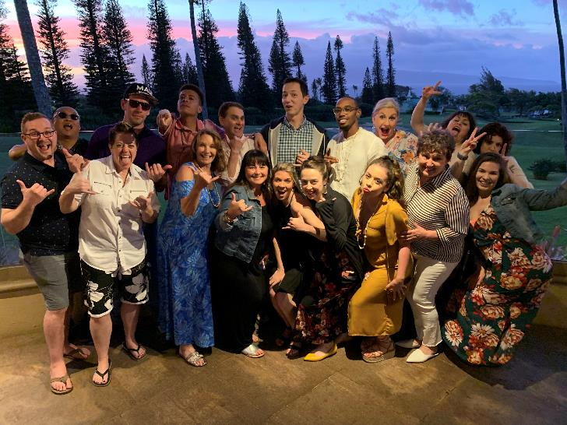
We did it!
THE BHAG

Slide 16
Thank You
Questions?​

